Slide 1

SO WHERE ARE WE GOING NEXT?

Slide 2
A lot done…

Slide 3
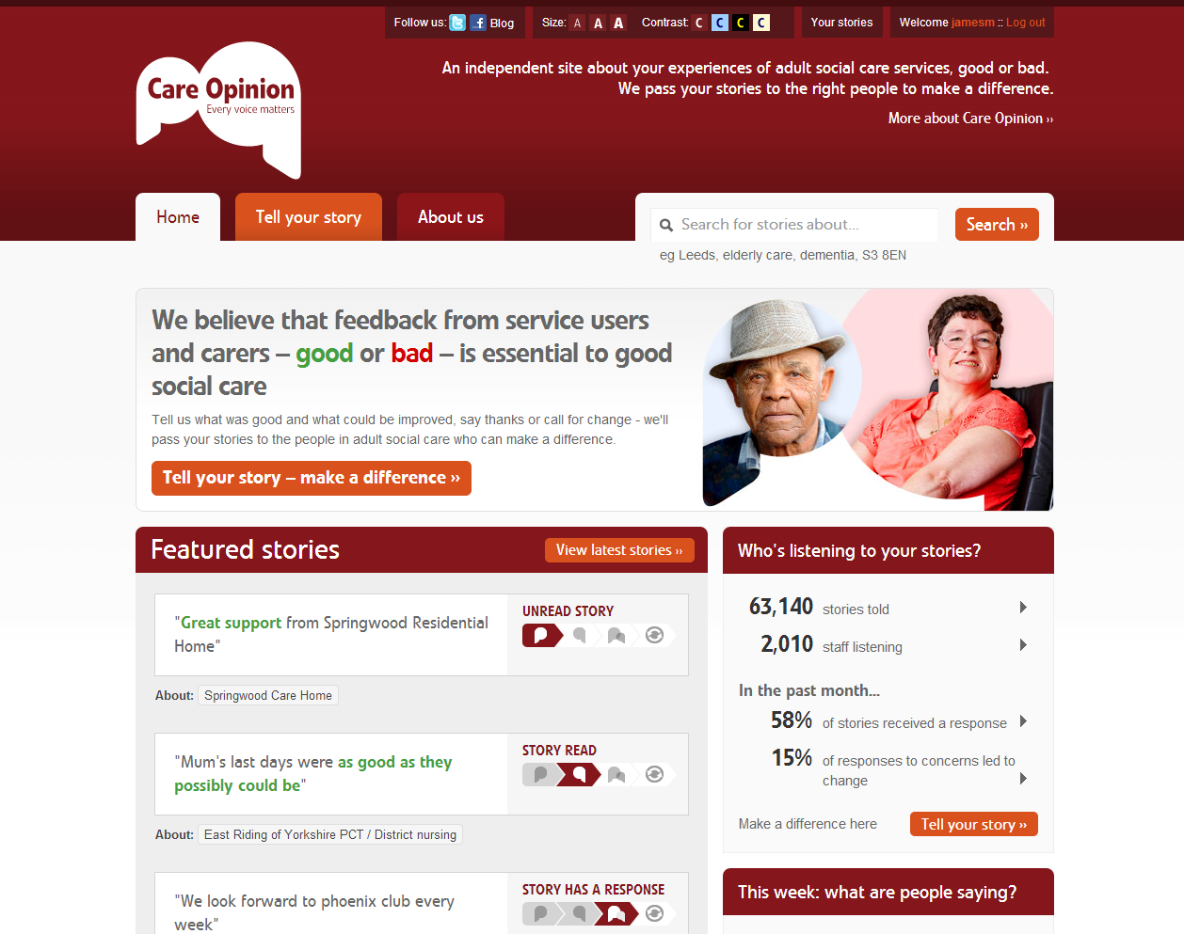

Slide 5
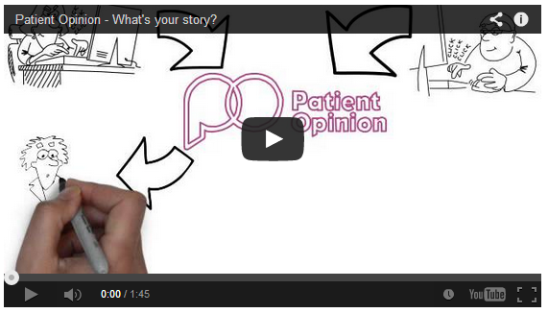
Animation

Slide 6
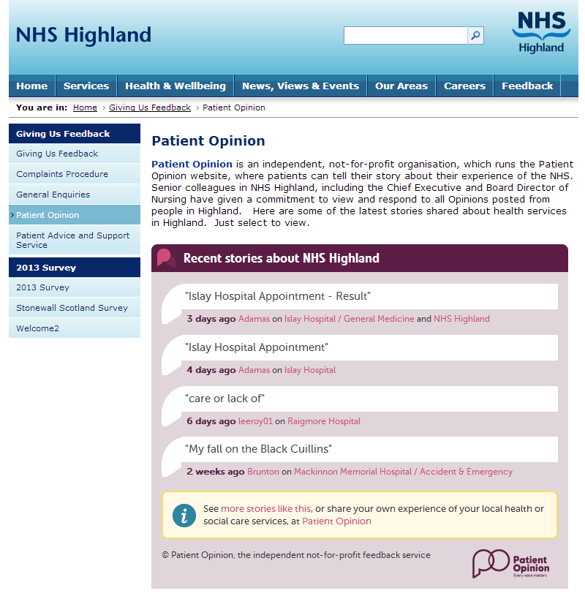
Widgets

Slide 7
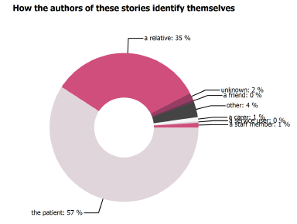
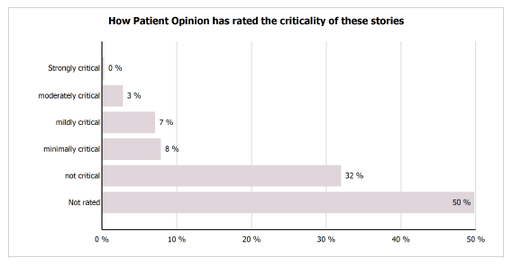
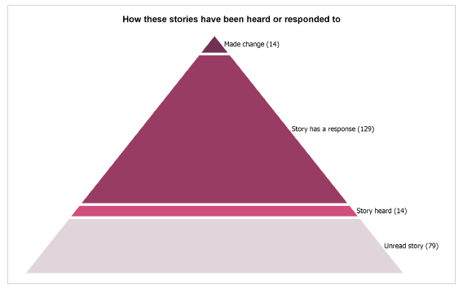
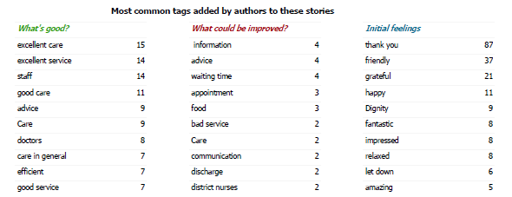

Slide 8
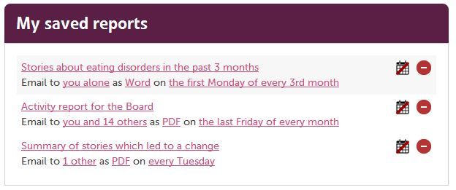

Slide 9
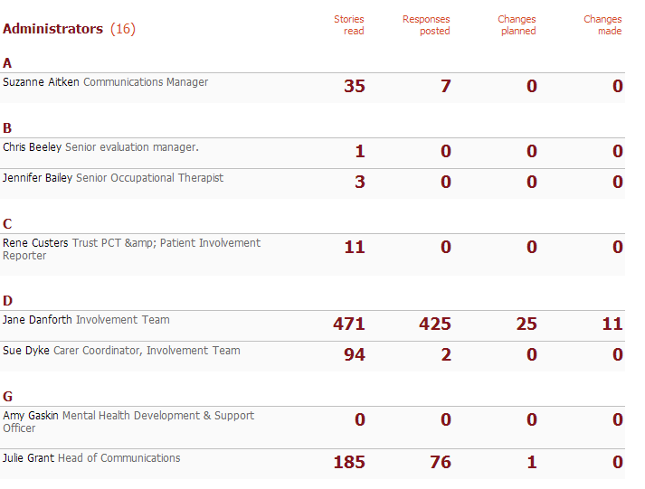
Member activity reports

Slide 10
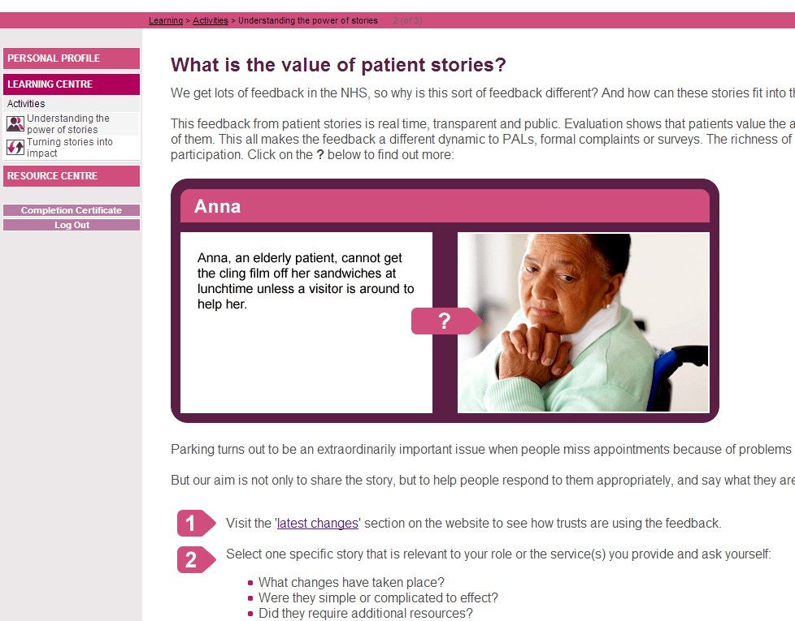
E-learning

Slide 11
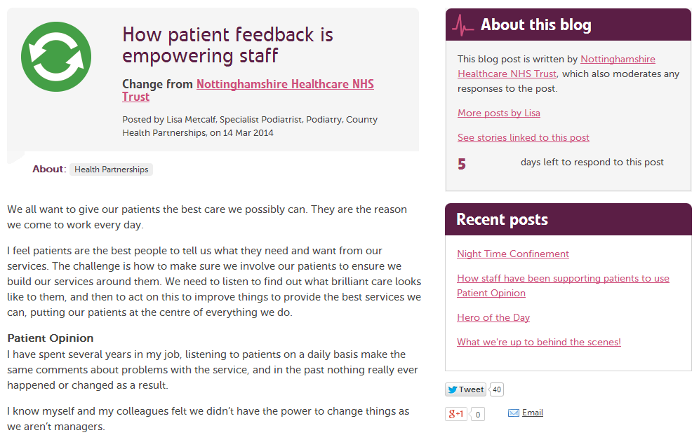
Subscriber blogs

Slide 12
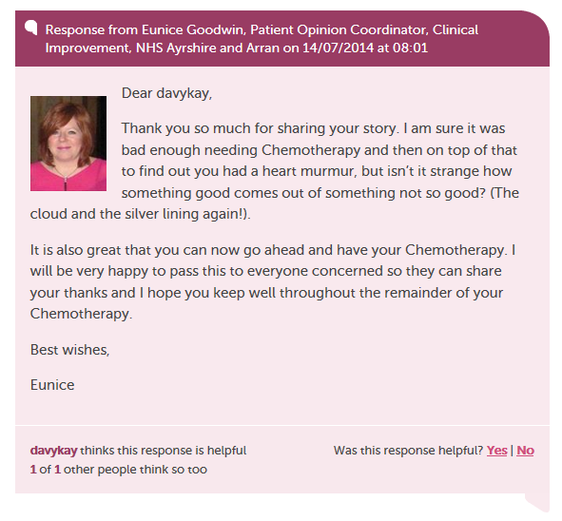
Helpful responses

Slide 13
A lot still to do…

Slide 14
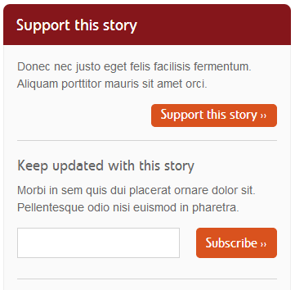
Support and follow

Slide 15
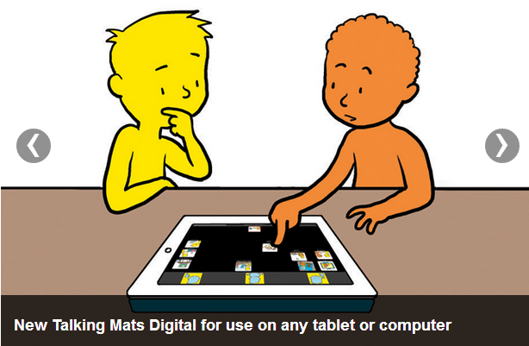

Accessibility

Slide 16
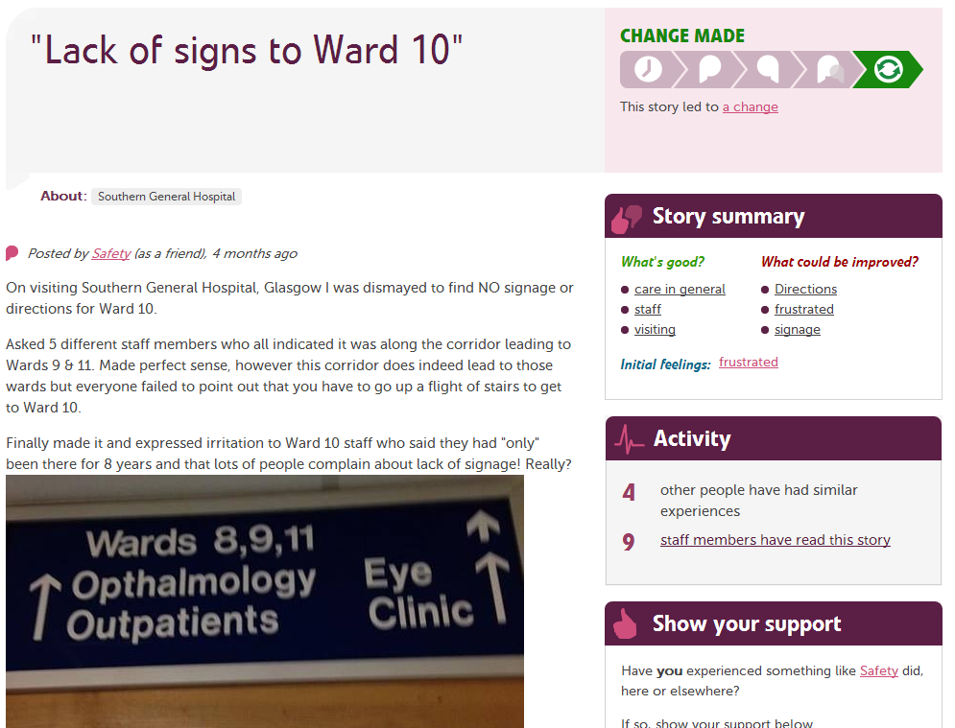
Picture feedback?

Slide 17
But this isn’t really about technology…

Slide 18
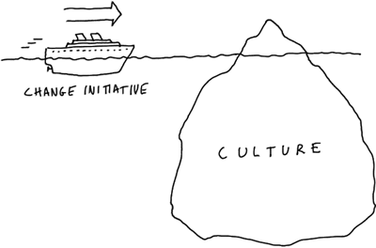
Changing culture in the NHS

Slide 19
9 levels of online engagement
9
The absence of fear
8
Everyday Patient Opinion
7
Widening staff involvement as active participants
6
Widening staff involvement as recipients
5
Initial commitment
4
Engagement
3
Acceptance
2
Controlling or organisation-centric
1
Resistance or defensiveness
1

Slide 20
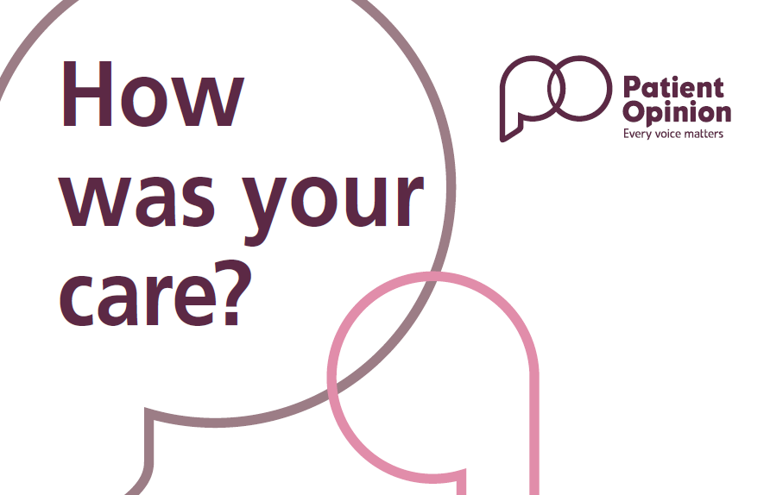
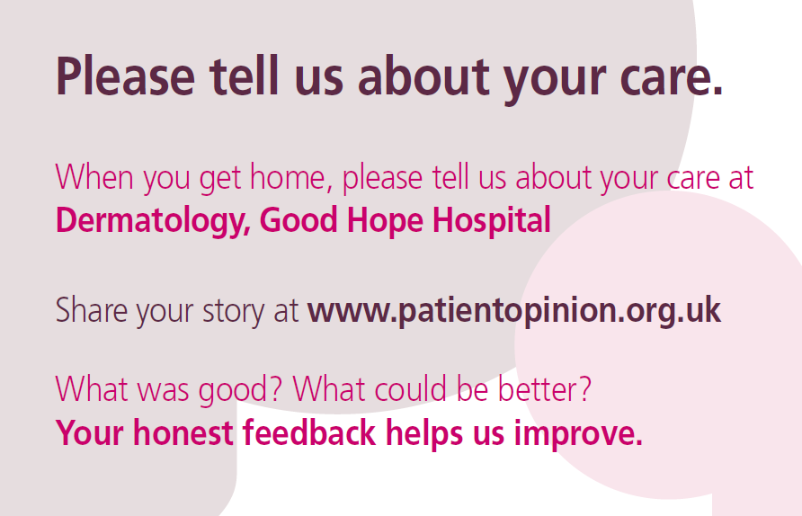

Slide 21
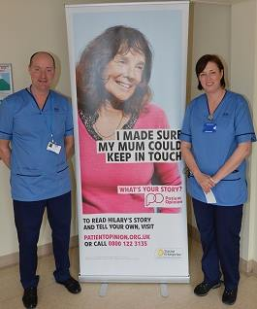
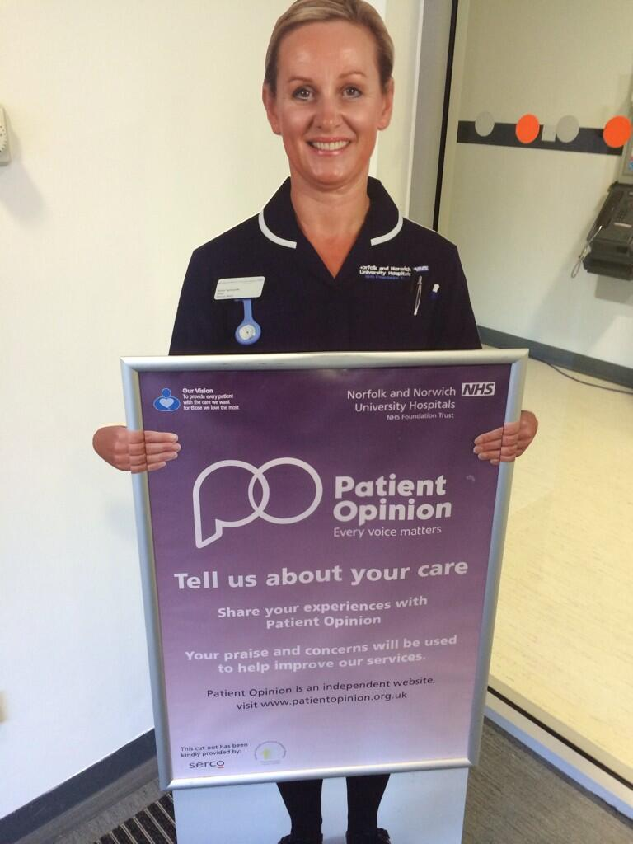

Slide 22
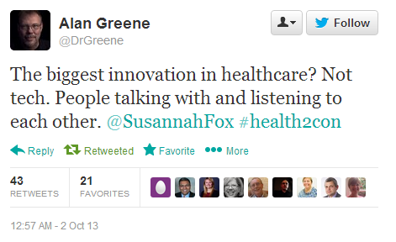

Slide 23
Berwick Report, August 2013
“Hear the patient voice at every level – even when that voice is a whisper”

Slide 24
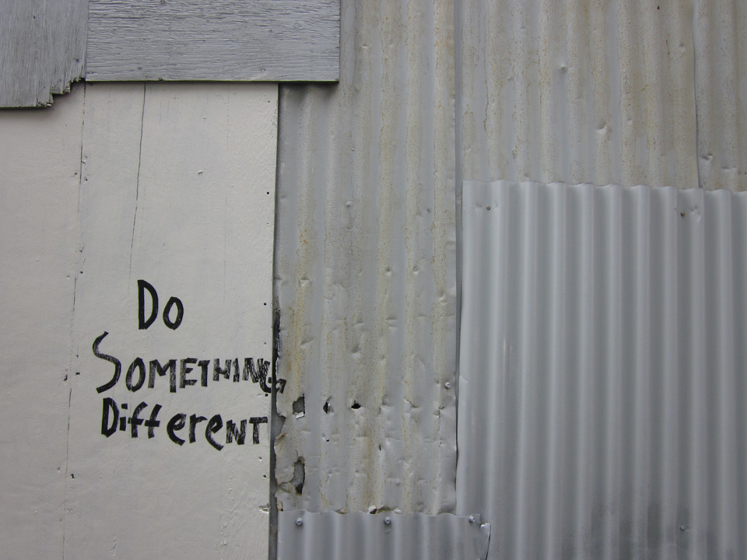
TAKE ACTION!

Slide 25

THANK YOU FOR BEING HERE

