Slide 1




SELDOM HEARD VOICES
Autumn Conference 2023
Victoria Sullivan
Care Opinion Manager
Birks of Aberfeldy

Slide 2


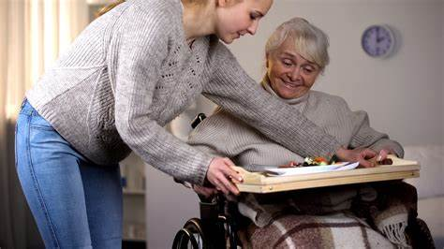
CONTENT
BSL and Translation
Volunteers
Picture Tiles
Carers
Children and Teens
Rural Communities
What’s Next?

Slide 3




Bsl & TRANSLATION
NHS Tayside Corporate Equalities Team

Slide 4


BSL Workflow
BSL user tells their story using text (or is supported to do so)
Care Opinion moderates the story and sends it to the Interpretation & Translation Service
Moderation Training
The Interpretation and Translation Service films a member of the team telling the story in BSL
This story is then posted on Care Opinion in text form with a link to the BSL video
Care Opinion will send alerts to the Interpretation & Translation Service if the story is about their work
If the story is about other NHS Tayside services, Care Opinion publishes the story, sending alerts to relevant service and to the Interpretation & Translation Service
The Interpretation & Translation Service responds to the story in text form and includes a link to the BSL video response
The service responds to the story in text form which is moderated by Care Opinion
The Interpretation & Translation Service creates a BSL video of the service’s response and sends the video link to Care Opinion to post together with the text response

Slide 5
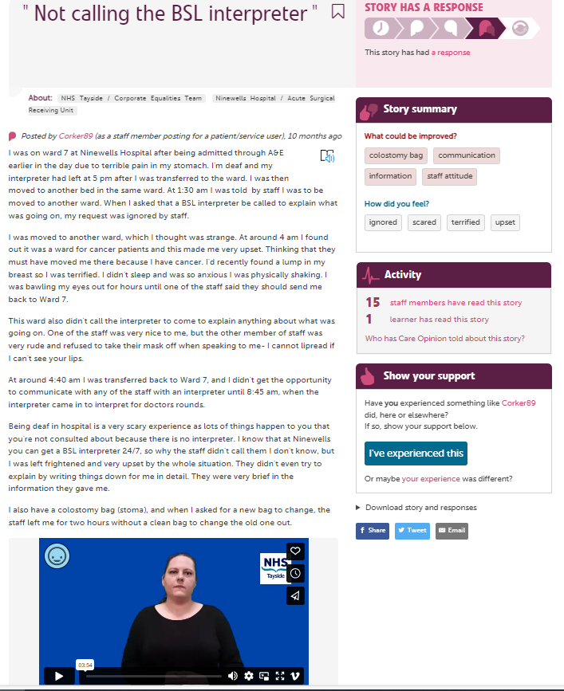


Slide 6
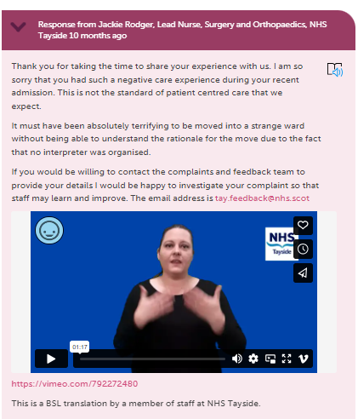

Slide 7

Translation Workflow
Author writes their story in their native language and submits to Care Opinion
Care Opinion requests a translation from NHS Tayside’s Interpretation & Translation Team
Interpretation & Translation Service translates the text into English
Moderation Training
Care Opinion moderates the English version of the text
The story is posted on Care Opinion in both English and the author’s native language
Care Opinion will send alerts to the Interpretation & Translation Service if the story is about their work
If the story is about other NHS Tayside services , Care Opinion will publish the story, sending alerts to the relevant services as well as the Interpretation & Translation Service
The Interpretation & Translation Service responds to the story in both English and the author’s native language
The service responds to the story, which is then moderated by Care Opinion
The Interpretation & Translation Service is alerted when a response is published by the service
The Interpretation & Translation Service posts their response in the author’s native language

Slide 8

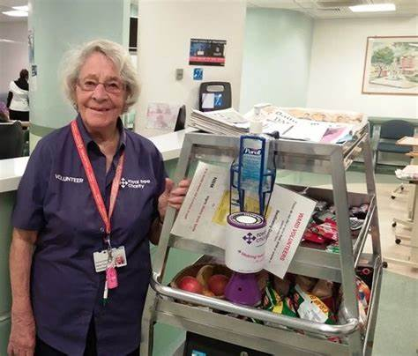
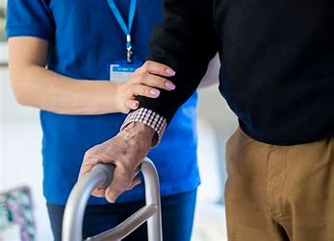

VOLUNTEERS
NHS Tayside Volunteers Service

Slide 9
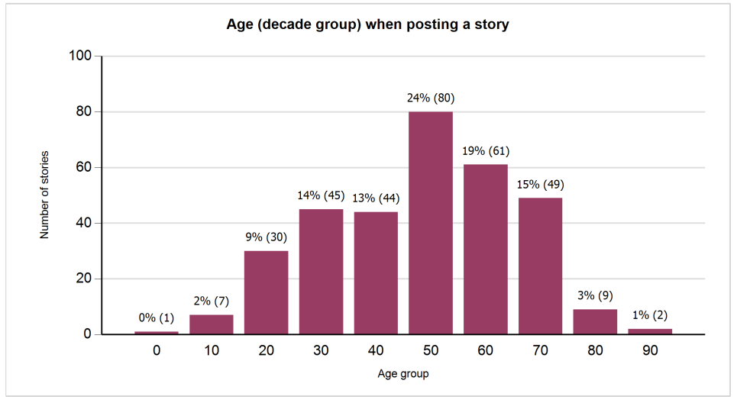


Slide 10

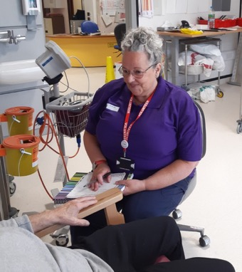

VOLUNTEERS
Oncology
Radiotherapy
Renal
Maternity

Slide 11

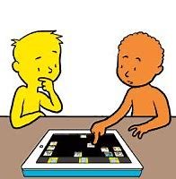
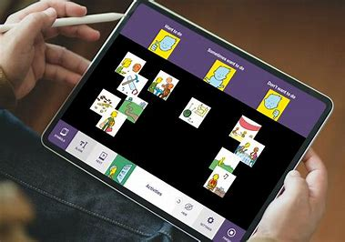

PICTURE TILES

Slide 12
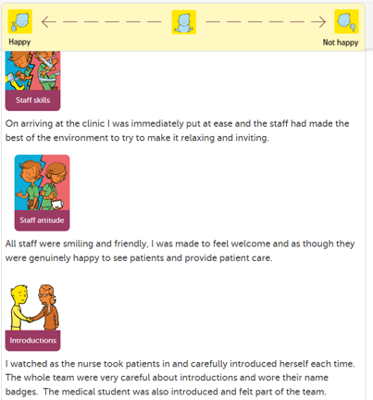
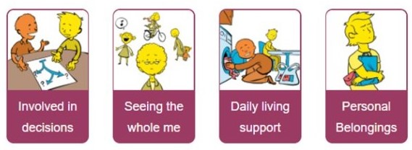
PICTURE TILES
1.5% of all NHS Tayside Care Opinion stories
Picture Tiles Training

Slide 13
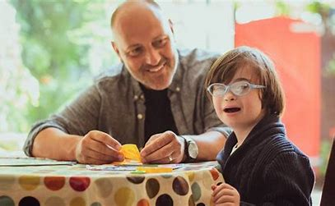

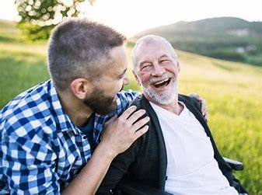
CARERS
NHS Tayside Carers Network

Slide 14
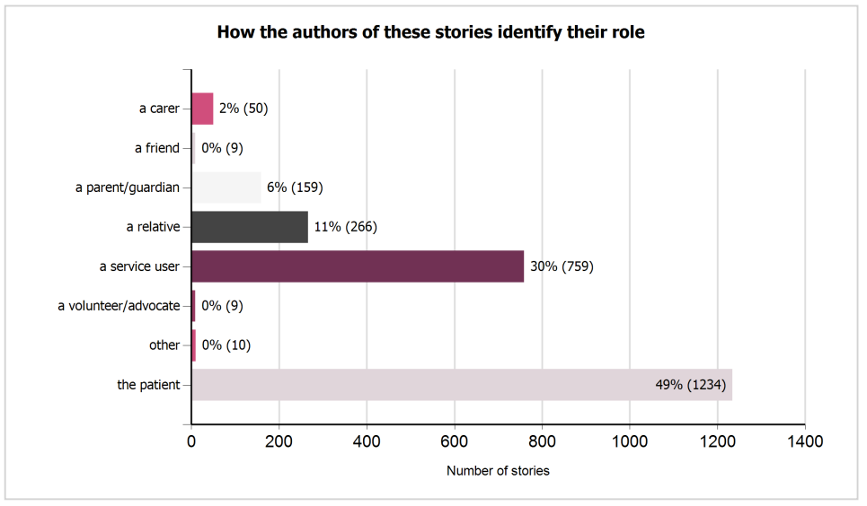

Slide 15





CARERS
2% of all NHS Tayside Care Opinion stories
Carers networks
Foster carer stories

Slide 16
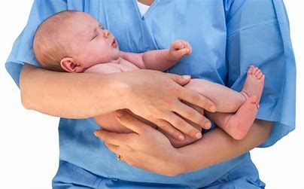



CHILDREN AND TEENS
NHS Tayside Paediatrics
Children & Young People’s Services

Slide 17
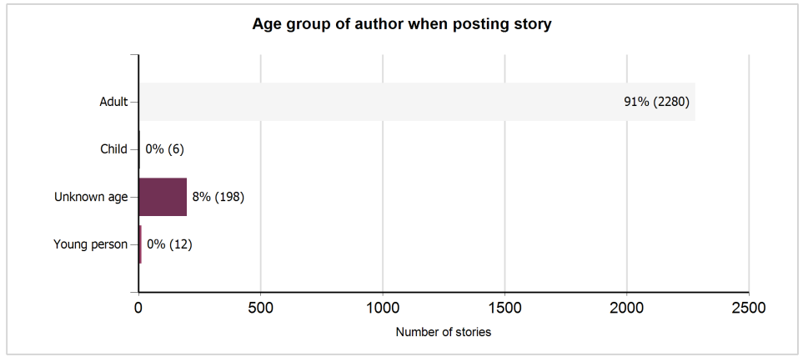

Slide 18

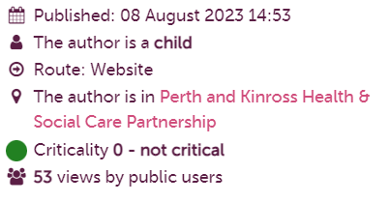

CHILDREN AND YOUNG PEOPLE’S STORIES
Paediatrics
Child Development Centre
CAMHS
Health Visiting
Paediatric Complex Disabilities Services
Young People’s Unit
School Nursing

Slide 19



RURAL COMMUNITIES
NHS Tayside
Perth & Kinross HSCP
Angus HSCP

Slide 20


RURAL VOICES
9% of stories about Community Services
Collaborative working relationship with HSCPs
Joined up picture of Tayside
Perth & Kinross HSCP | Angus HSCP | NHS Tayside
176 Responders 244 Stories | 141 Responders 193 Stories | 663 Responders 2,515 Stories
980 Responders 2,952 Stories

Slide 21




WHAT’S NEXT?
NHS Tayside

Slide 22
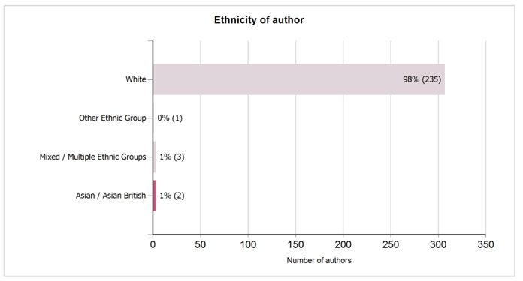
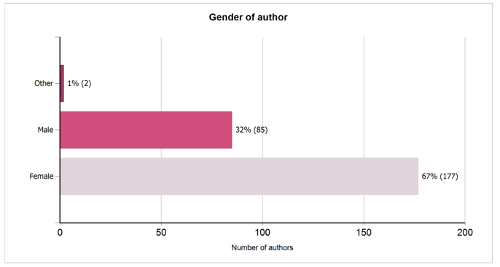

Slide 23


NEXT STEPS
Author Gender and Ethnicity
Critical stories
Enhanced Reporting
Staff Opinion

Slide 24



Thank you
Glamis Castle
Kenmore
Victoria Sullivan
NHS Tayside Care Opinion Manager
victoria.sullivan9@nhs.scot

