Slide 1



Online patient feedback and validated questionnaires: how do they compare?
Session 2.2
3rd July 10:00-11:15
Rebecca Baines
Rebecca.baines@plymouth.ac.uk
University of Plymouth
Patient Research partner: John Donovan
@Rebecca_Baines_

Slide 2



Rationale & aim
Considered most helpful in facilitating reflective practice, but also most difficult to collect (UMbRELLA, 2018, AoMRC 2019)
“Doctors and patients raise questions and challenges about the effectiveness of current feedback mechanisms.” (Pearson, p.26)
A third of respondents (4,445/13,537 = 32.8%) distributed their feedback forms personally (UMbRELLA, 2018)
Need for current feedback tools to be refined as both doctors and patients remain cynical about their existing value and acceptability
1 – Who do patients talk about when sharing their psychiatric care experiences online?
2 – What do patients share about their psychiatric care experiences online?
3 – How does this compare to the content used in existing questionnaires?

Slide 3






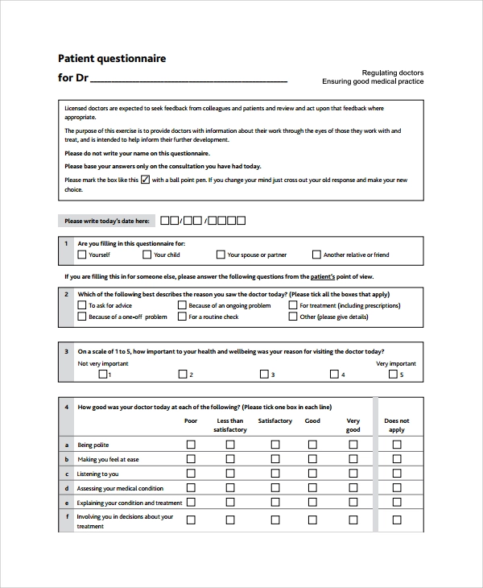
Methods
Co-production Mental health Patient partner: John
Search terms and tag features
2005 -2017
Who people talked about
What they talked about
GMC patient questionnaire
ACP 360 patient questionnaire

Slide 4

Results – question 1, who?
152 stories included
33% positive (50/152), 16% mixed (n=25/152), 51% critical (77/152), variety of conditions, experiences & diagnoses
“I was originally transferred to my local Community Mental Health Team from CAMHS services in another area. I had a skilled and compassionate Social Worker, a great Psychiatrist and a brilliant Support Worker… I also had a care co-ordinator... A new Psychiatrist eventually said I could have a CPN… I was getting CBT from the Psychologist there… The mental health helpline have been very rude to me on occasions… The same goes for the Crisis teams… on one occasion the Consultant told me… On discharge from the Community team I was told I could self-refer myself back if I ever needed help, when I tried to do this this was refused. Even my GP said I could do this.”
Patients rarely describe psychiatric care in relation to a single psychiatrist
Additional roles/and or services

Slide 5


Results – question 2, what?
“I wish to highlight the care from my Consultant Psychiatrist. At no point have I felt out of the loop. Her thorough, learned, consistent understanding, compassion, encouragement, gentle and honest method of practice has allowed me to go from strength to strength. I have always been part of any decisions made both as an inpatient and outpatient. I feel so cared for, understood and supported”
Positive and critical aspects
Often in combination

Slide 6
Results – question 2, what?
Helpful behaviours
Unhelpful behaviours
Listened to
Supportive
Caring
Understanding
Treated with dignity and respect
Shared decision making
Non-judgemental
Kind
Spends time
Helpful
Discusses side effects of medication
Lack of shared decision making
Detrimental attitudes
Poor communication
Hears, but doesn’t listen
Power imbalance
Judgemental
Lack of carer involvement
Dismissive
Lack of respect
Lack of sensitivity
Lack of understanding
“With the help and support I have received I now have work as a volunteer, a house and a life.”
“I'm more able to be the kind of mum that I want to be”
“The way the psychiatrist treated me was degrading. It took a lot for me to go there and tell him how I felt… he treated me like a child. I felt worse when I left and ended up going home and attempting suicide.”

Slide 7
Results – question three, how?
Care Opinion analysis | ACP 360 Questionnaire | GMC Patient Questionnaire
Listened to | “Listens to what I say” | “Listening to you”
Supportive | “Offers me hope and optimism” | -
Caring | “Shows warmth and is genuine and understanding” | -
Understanding | “Shows warmth and is genuine and understanding” | -
Treated with dignity and respect | “Shows respect for me” | -
Involves (Shared decision making, carer involvement) | “Values my opinions” “Includes my opinions when making decisions with me” “Asks me about my points of view” “Takes into consideration the needs of my family and/or carers” “Asks the opinions of my family and/or carers where appropriate” | “Involving you in decisions about your treatment”
Non-judgemental and accessible | “Is friendly and easy to approach” | “Making you feel at ease”
Kind | - | -
Spends time with patients | - | -
Helpful | - | -
Discusses medication side effects and provides information | “Provides useful information about my care and treatment when I need it or ask for it” “Makes information easy for me to understand” | -

Slide 8
Care Opinion analysis | ACP 360 Questionnaire | GMC Patient Questionnaire
Listened to | “Listens to what I say” | “Listening to you”
Supportive | “Offers me hope and optimism” | -
Caring | “Shows warmth and is genuine and understanding” | -
Understanding | “Shows warmth and is genuine and understanding” | -
Treated with dignity and respect | “Shows respect for me” | -
Involves (Shared decision making, carer involvement) | “Values my opinions” “Includes my opinions when making decisions with me” “Asks me about my points of view” “Takes into consideration the needs of my family and/or carers” “Asks the opinions of my family and/or carers where appropriate” | “Involving you in decisions about your treatment”
Non-judgemental and accessible | “Is friendly and easy to approach” | “Making you feel at ease”
Kind | - | -
Spends time with patients | - | -
Helpful | - | -
Discusses medication side effects and provides information | “Provides useful information about my care and treatment when I need it or ask for it” “Makes information easy for me to understand” | -

Slide 9


Discussion
Implications
Helpful?
Realistic?
Opportunity?
What is valid feedback?
Different language
Missing areas of importance
More narrative comments
Message - once every five years
Why is it collected and collected in the way that it is?
Can online feedback offer something different/better?
Typically excluded from the design, administration and evaluation of patient feedback tools (Baines, 2019)
Less than 1% of stories posted by CO. Why?

Slide 10
Any questions?
Rebecca Baines
Rebecca.baines@plymouth.ac.uk
University of Plymouth
Patient Research partner: John Donovan
@Rebecca_Baines_

