Slide 1
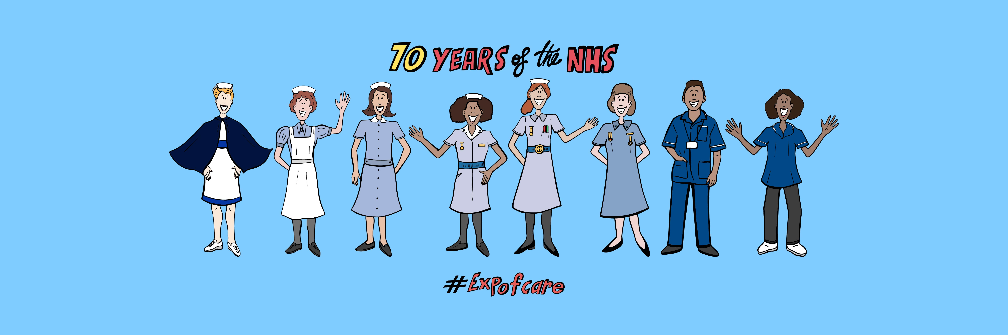

How do non-clinical staff contribute to patient experiences of care?
James Munro, CEO, Care Opinion CIC
@jamesfm55
@careopinion

Slide 2
Plan of the webinar
Are non-clinical staff important to patient experience?
  Spoiler: Yes!
  But in what ways? And why?
What are the implications?
  Feedback and responding
  Personal reflection and support
  Quality improvement

Slide 3
Research study
Experiences of non-clinical staff
  Including 6 staff groups
By Sarah Parker and Danny Mackay
  Medical students, Sheffield Medical School
Nov-Dec 2016
Full report available online
  https://www.careopinion.org.uk/blogposts/688

Slide 4
An analysis of 497 stories of care
Posted by patients and carers
Experiences of
  Receptionists
  Porters
  Catering staff
  Cleaners
  Security staff
  Parking attendants

Slide 5
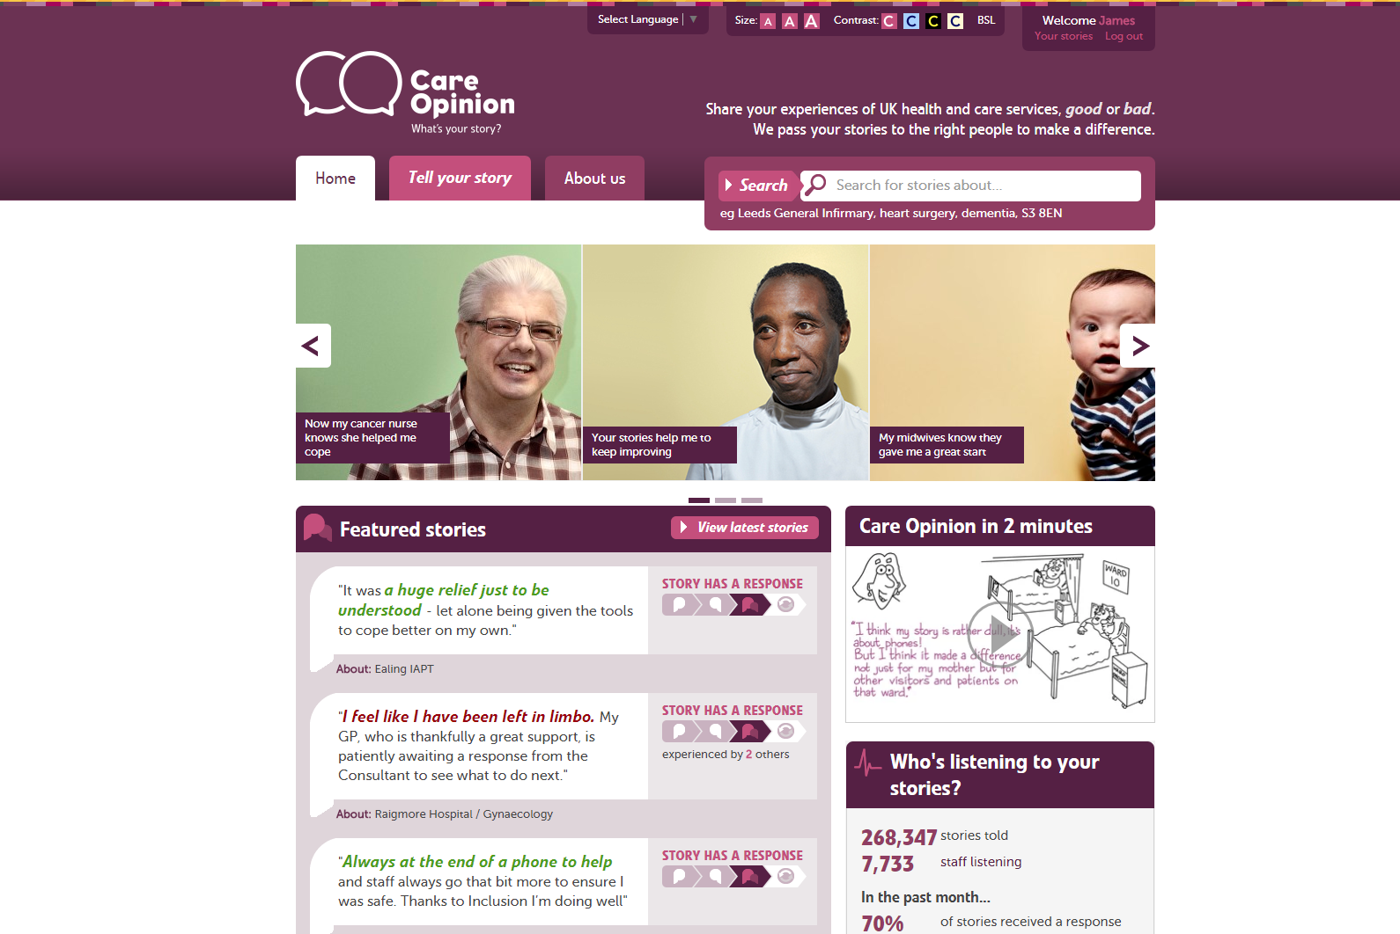

Slide 6
260,000
stories
8,000
staff + students listening
stories read
95 million
times
100,000
visitors per week

Slide 7
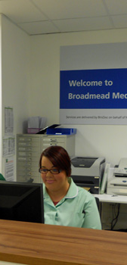
Receptionists
It’s all about communication
  With the patient
  With the wider care team
What matters?
  Attitude/communication style
  Confidentiality
  Accuracy
  Timeliness and efficiency

Slide 8
Teamwork
“I've found every member of staff, from the front-line receptionist to the doctors and nurses, to be most helpful, efficient and courteous.
I've had full clarity on test results and available appointments.”
“Despite everybody behind that desk being fully aware of my circumstances, nobody did anything.
Nobody checked up on me. Nobody could answer my questions.”

Slide 9
Attitude
“However when I got there I was met by a lovely receptionist who took all my details, she was so friendly I was put at my ease.”
“On attendance I was obviously suffering from a miscarriage and was covered in blood only to be met by a receptionist reading a magazine and eating chocolate who abruptly asked why I hadn’t made an appointment.”

Slide 10
Structural issues
“This poor service proves that the hospital reception/ computer system has not improved.”
“More privacy needed in the reception area, so that confidentiality is upheld.”
“I had to give my personal details to a receptionist who would then pass it on to a triage team who then decided whether I needed to see a GP!”

Slide 11
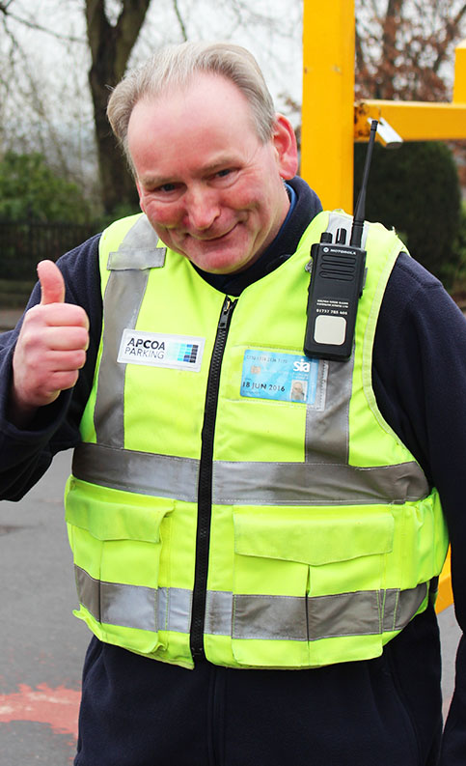
Parking attendants
It’s all about helpfulness
  Finding a space
  Paying the charge
  Getting out
What matters?
  Attitude/communication style
  Awareness of ability/disability
  Car park design, policies, costs

Slide 12
Attitude
“Though I must say the parking attendant in the car park in front of the tower is the most cheerful and helpful person you could ever wish to meet.”
“I have recently been in hospital myself after being treated for breast cancer and found the stretch difficult.
What a pity that these people who are usually the first port of call at the hospital really let down your experience”

Slide 13
Awareness of needs
“The car parking attendants have been instructed to be intolerant of disabled people parking in the main car park.”
“Nightmare arriving with officious parking attendant at hospital entrance who wouldn't let you stop even for putting down.
Had to ignore him in the end as no way could patient walk from car park.”

Slide 14
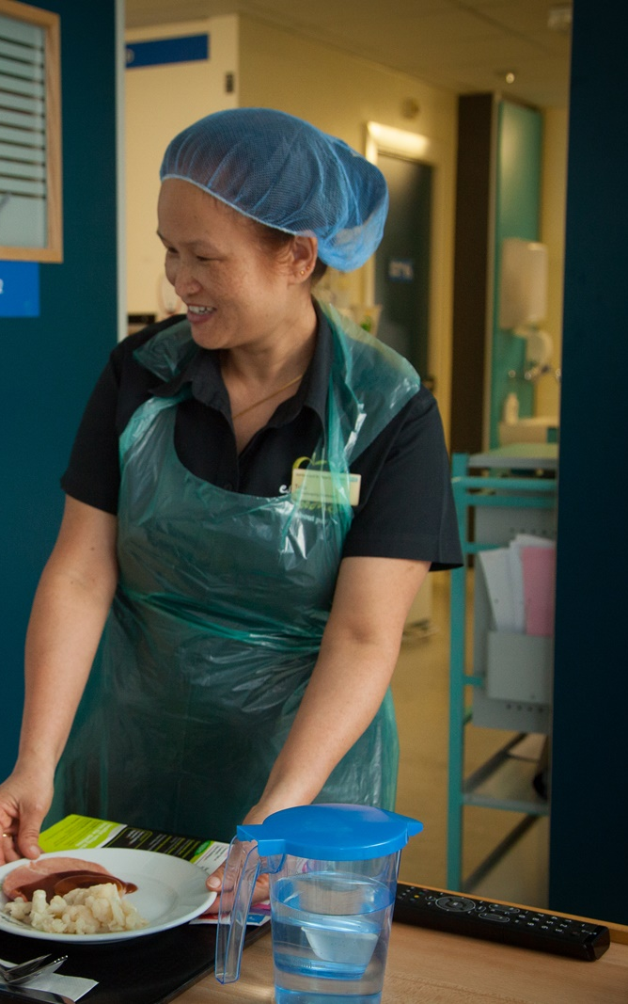
Catering staff
It’s all about personal care
  Food you like
  Food you can eat
  Help with eating
What matters?
  Teamwork
  Attitude and helpfulness
  The right food at the right time

Slide 15
Attitude and helpfulness
“My thanks go to the male member of catering staff who hunted the building for a nice veggie meal.”
“The catering staff on the ward I was on were also dreadful. Very unfriendly and unhelpful.”

Slide 16
Help with eating
“Some of the catering staff could not care less if you could reach the food or not.”
“I watched our friend pick up the biscuit packet, look at it, fiddle with it, and then put it down again.
Her poor arthritic hands could not manage the task of tearing the packet open.”

Slide 17
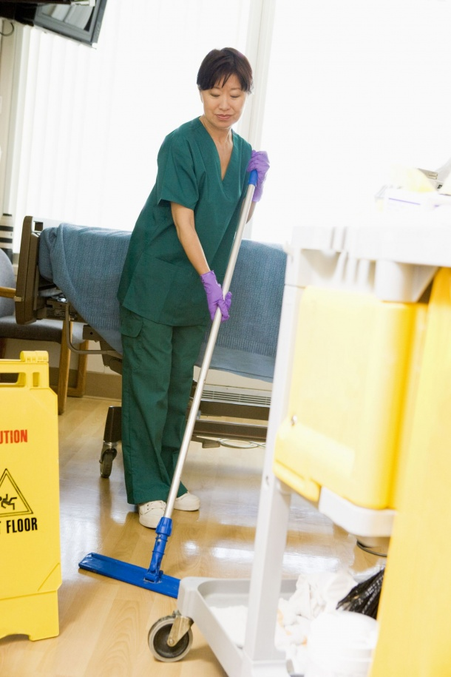
Cleaning staff
It’s all about feeling safe
  Is it clean?
  Is it safe?
  Do they care?
What matters?
  Cleanliness and safety
  Efficiency and organisation
  Attitude and teamwork

Slide 18
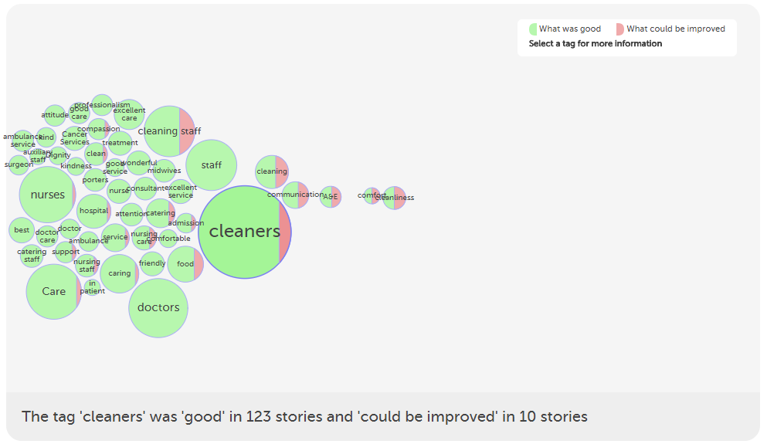
https://www.careopinion.org.uk/vis/s8g8x

Slide 19
Cleanliness/safety
“The ward was kept very clean and I had no worries about catching any hospital viruses.”
“They used their dirty old mops time and time again, and then take their gloves off and start serving food.”

Slide 20
Efficiency
“The ward had its own team of cleaners who did not stop working or leave a single thing uncleaned.”
“The ward he was in had blood on the sheets, floors and curtains. It was not cleaned during the time he was in there.”

Slide 21
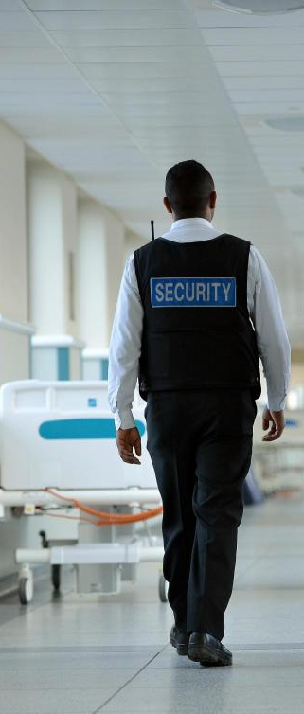
Security staff
It’s all about safety
  Who can get in and out?
  What if people are violent?
What matters?
  Helpfulness and attitude
  Convenience vs risk
  Staffing levels
  Smoking policy!

Slide 22
Helpfulness
“The security guard at the main entrance escorted myself and mother to our car shielding us from the rain with his umbrella.”
“The reception was manned by a security guard who did not seem to care about his job.”

Slide 23
Staffing levels
“Security staff were very visible and dealt with one undesirable visitor (not patient) very effectively.”
“There should be adequate staff there and security so people who are in distress or are unwell can wait inside.”

Slide 24
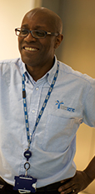
Porters
It’s all about individual care
  Treated as a person
  Needs understood
What matters?
  Friendliness
  Helpfulness
  Staffing levels

Slide 25
Personalised care
“Each time I was picked up by a porter who was chatty, amusing and very socialable. I can't tell you how lovely that is when you are feeling sick, concerned and bemused.”
“He escorted me to Ward B24 despite being rather a distance away from the foyer.”

Slide 26
Understanding of needs
“One porter actually took it upon himself to talk to his boss when he realised how much pain I was in.”
“He came to my bedside when I was in so much pain and was upset, he showed empathy, continued to talk to me and attempted to make me feel better.”

Slide 27
Staffing levels
“Spent one hour in the corridor then another hour waiting for a porter to take me to the discharge ward in a wheelchair.”
“She had been left from around 4 o'clock in the morning until the porters came about 11am to take her to the mortuary.”

Slide 28
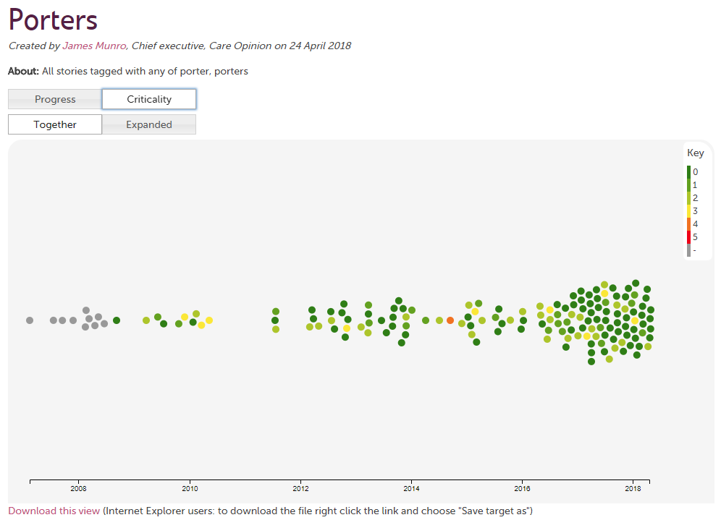
Story swarm
https://www.careopinion.org.uk/vis/42c33

Slide 29
In a nutshell
Receptionists, parking attendants
  Facilitating access to care
Security and cleaning staff
  Making a place safe
Porters and catering staff
  Providing individual care

Slide 30
What vulnerable people ask
Do they get things right?
Do they care?
Do I trust them?
A trusting relationship is built or broken by all staff

Slide 31
Non-clinical staff have a big impact
Helpful, friendly, caring
Teamwork
Individualised care
Safe environment
Clear communication
Advocating for the patient
Connection to a life outside

Slide 32
Non-clinical staff need to be aware of some clinical issues…
Yet are so important to patients precisely because they are not involved in clinical care

Slide 33
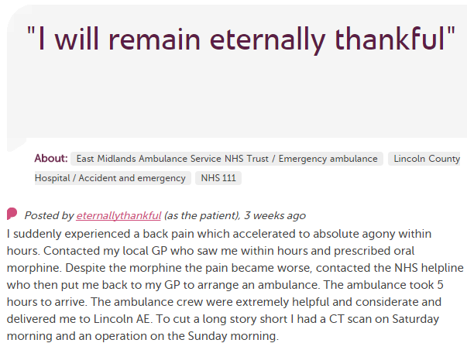











In each provider
Moderation
Clinical staff
Porters, reception, catering…
Pt exp, comms, complaints…
Alerting
CEO
Commissioners
Nursing, AHP students
Healthwatch
Researchers
Patient groups
CQC
Local authority

Slide 34
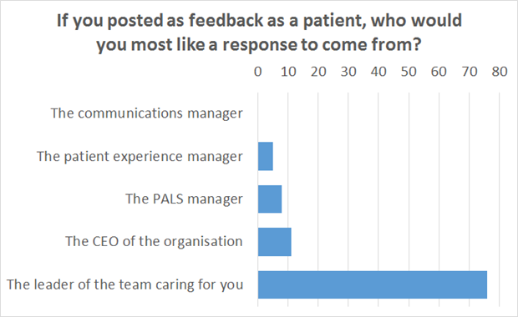

Slide 35
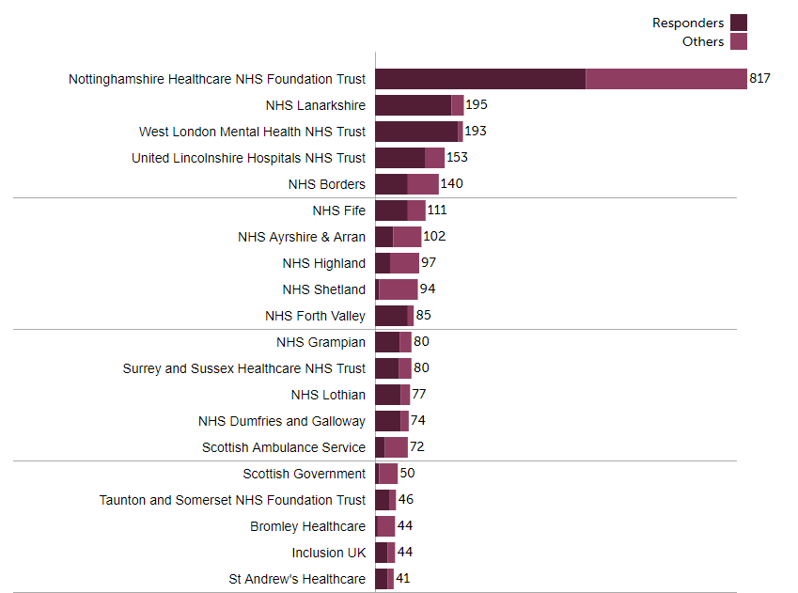

Slide 36
Hear the patient voice at every level – even when that voice is a whisper.
Don Berwick
August 2013

Slide 37
Can we include non-clinical staff in “hearing the voice at every level”?

Slide 38

How do non-clinical staff contribute to patient experiences of care?
Join us this evening for a tweetchat
#ExpofCare
8 till 9pm – drop in when you can!

