Slide 1
Feedback at the end of life
Funded by Dorset Clinical Commissioning Group
Saskie Dorman
Forest Holme Hospice, University Hospitals Dorset NHS Foundation Trust
Jackie Le Fèvre
values specialist at magmaeffect.com
Helen Snelgrove
Dorset HealthCare University NHS Foundation Trust

Slide 2
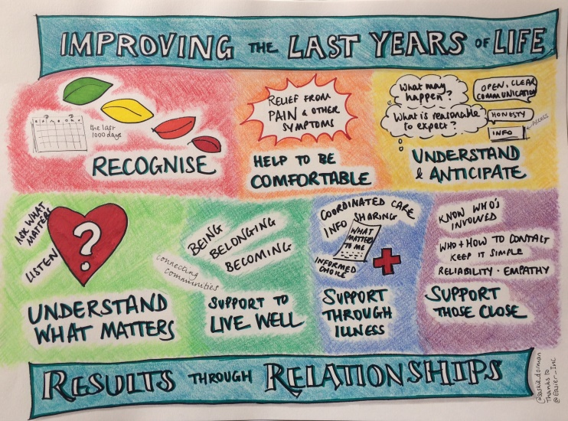
What really matters at the end of life?
What do the experiences and stories people share tell us about what really matters?
How do we know how well it’s going?
How can we improve?
How can we work together to develop a shared understanding and respond to what we find?
“Hear the patient voice, at every level, even when that voice is a whisper”
Don Berwick

Slide 3
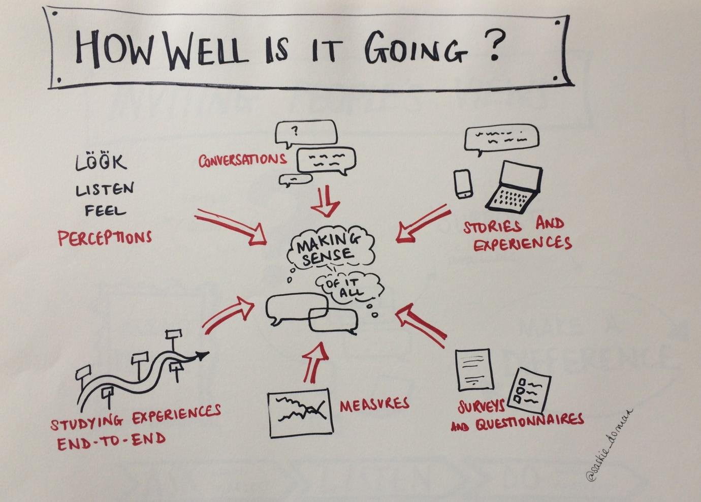

Slide 4
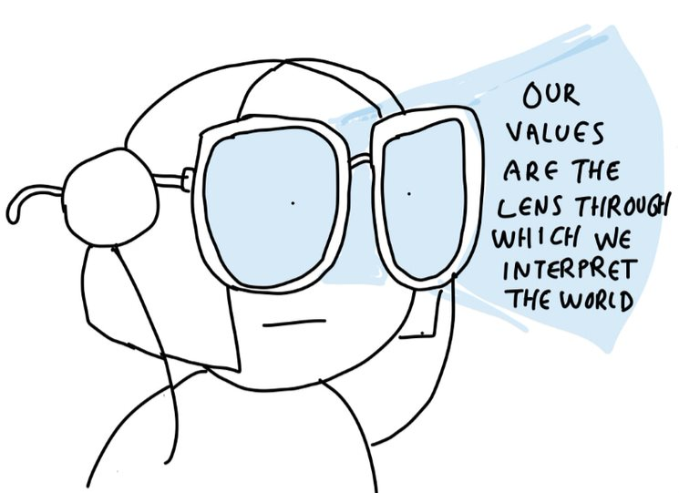

Slide 5
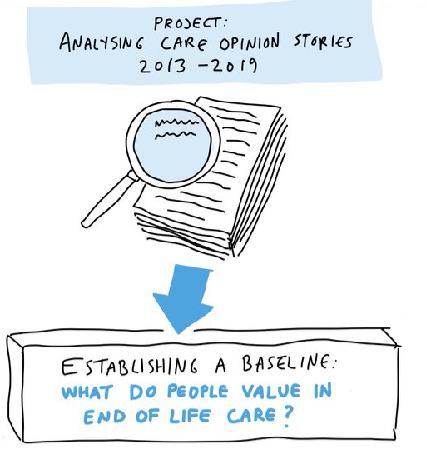
Establishing a Baseline
Care Opinion stories Sept 2013 to August 2019
Palliative Medicine – 362 stories = 57890 words
End of life/palliative care – 204 stories = 51590 words
Tagging narratives
Analysis using ValScan™

Slide 6
Top 10 Values End of life care / Palliative Care Palliative Medicine

Slide 7
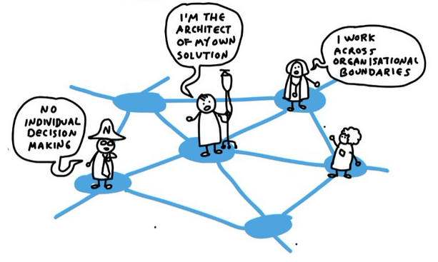
Interdependence…

Slide 8
A Comparison….
We used 37 stories contributed to Care Opinion concerning Covid-19 vaccination
There were 2,784 words

Slide 9
What does this show?
8/10 were common EOLC/Palliative Medicine
Care/Nurture
Empathy
Family/Belonging
Generosity
Interdependence
Community Support
Education/Knowledge
Service/Vocation
Vaccination 5/10 shared
Interdependence
Generosity
Empathy
Education/Knowledge
Care/Nurture
Notice…..
Many more Control values and they are at the top
BUT the nature/tone of the interaction that matters is still the same

Slide 10
…. Interdependence is a constant theme…….

Slide 11
Thank you

