Slide 1

Online patient feedback: citizens helping health services get better, at scale
James Munro, CEO, Care Opinion CIC
@jamesfm55

Slide 2
Who are we?
Non-profit community interest company
16 years experience
Working across UK, Ireland and Australia
Now the system-wide platform in
  Northern Ireland
  Scotland
  Western Australia

Slide 3
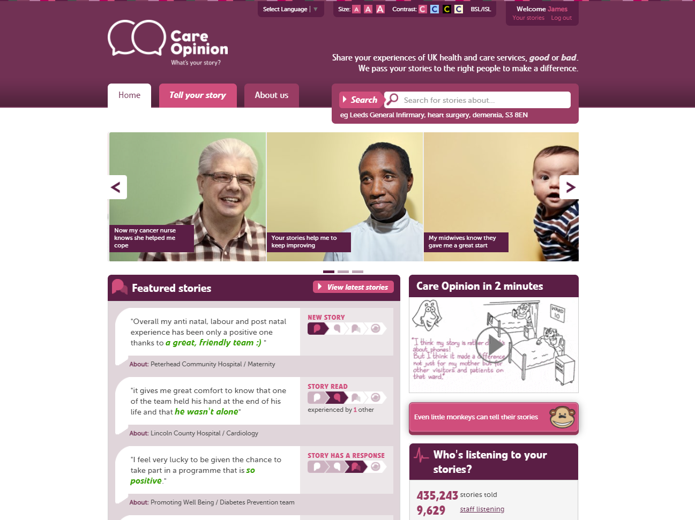

Slide 4
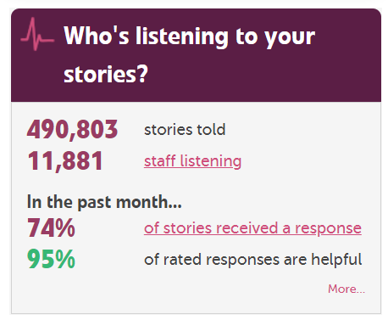

Slide 5
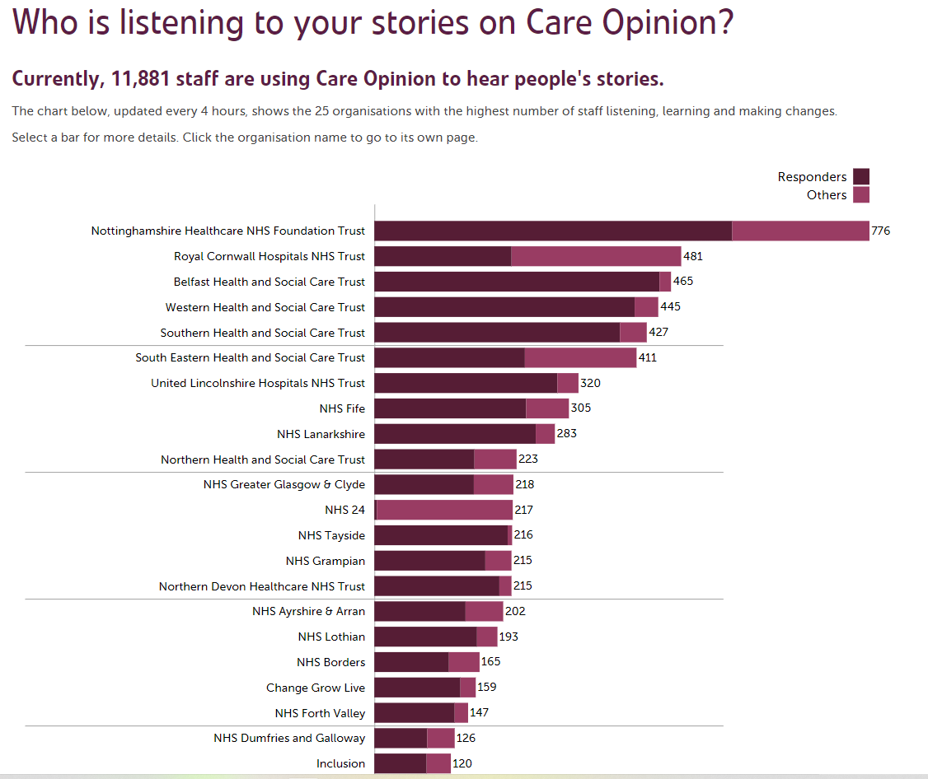

Slide 6
Vision
We want people to be able to share their experiences of health and care in ways which are safe, simple, and lead to learning and change.

Slide 7
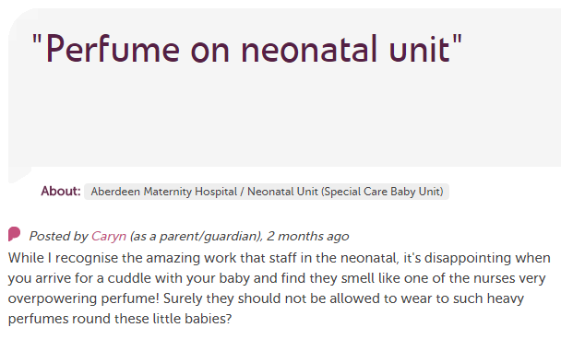
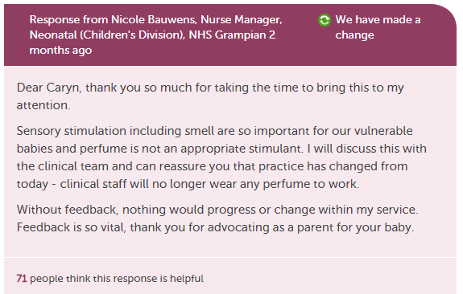
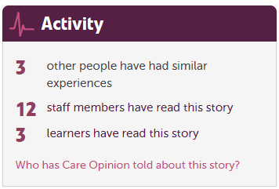

Slide 8
“It was a difficult time for me to go through and Care Opinion allowed me to control the speed and words rather than be rushed through Q&As or tick box scenario where things don't quite fit.”

Slide 9
“The fact I did not have to give my name made it a lot easier to provide feedback. I find it hard to do it in person.
I would like it to make changes.”

Slide 10
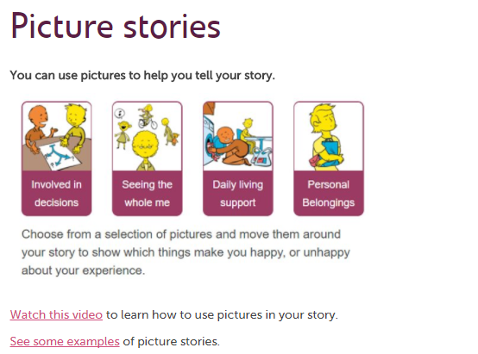

Slide 11

42% of UK adults have read online feedback about healthcare in the past year

Slide 12
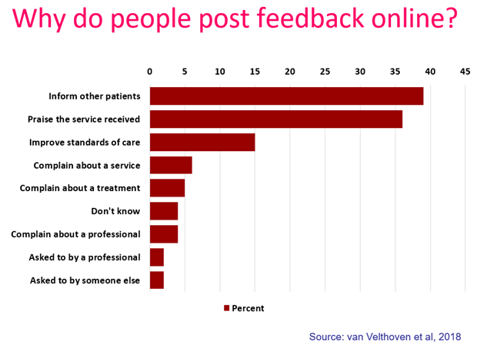

Slide 13
Improving (not complaining about) the NHS
And I think, when something isn’t right, I think it’s more about you just want them to improve. [INQ23: female, mid-thirties, maternity services]
[…] unless people speak out and the people who are in an influential position don’t know things are happening so, you know, when, where we realise I realise that, you know, the NHS is under such huge demands and everything else but, unless we tell them what’s wrong, they can’t put things right. [INQ11: female, 60, dementia services]
The NHS fails, we fail, like we need the NHS to not only survive but to thrive and keep going and any feedback, certainly I’m giving and I know a lot of people in my position are, it’s constructive, not because we’re being critical but because need this to work. [INQ16: female, mid-thirties, multiple long term conditions]
I firmly believe that in a subtle and perhaps longer term way, I am contributing to change. [INQ19: female, early thirties, mental health]

Slide 14
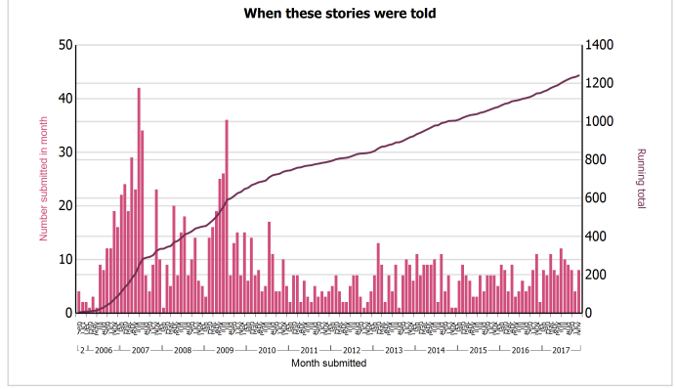
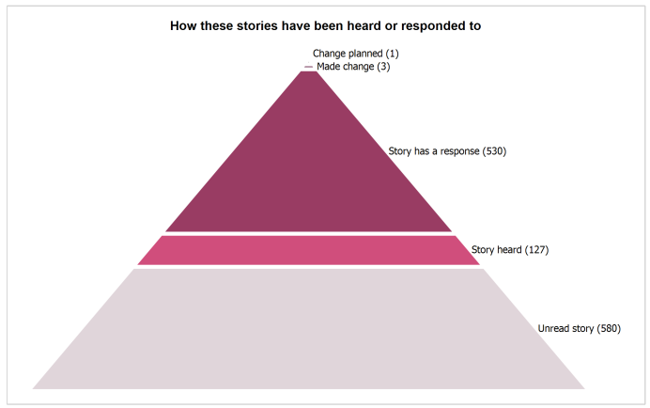
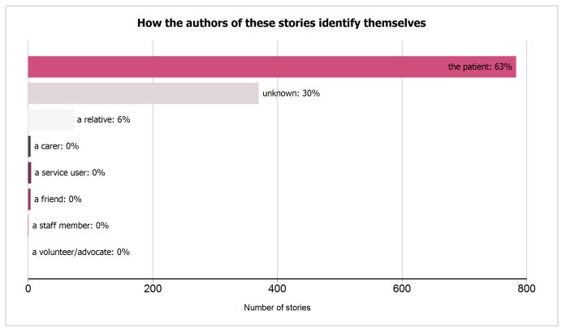
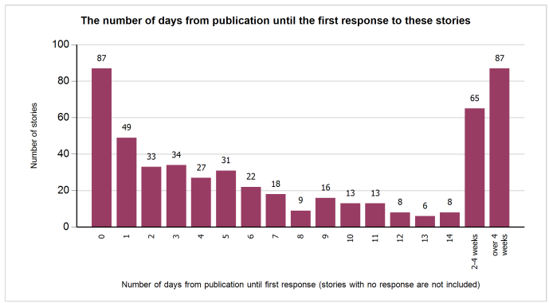

Slide 15
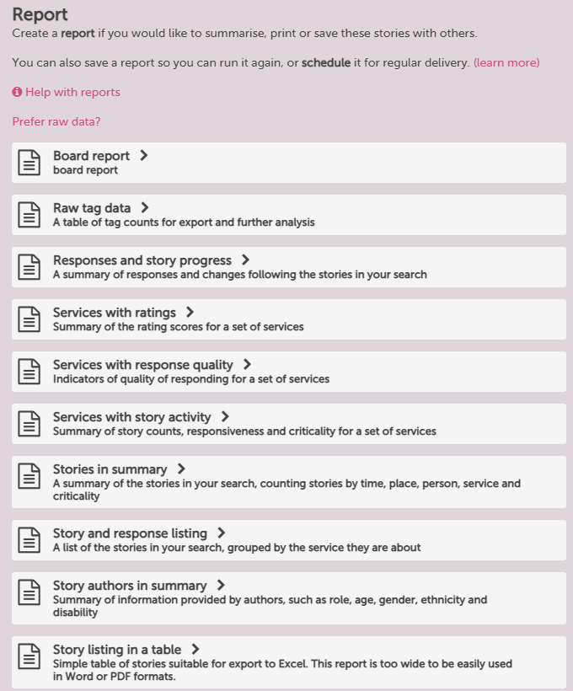
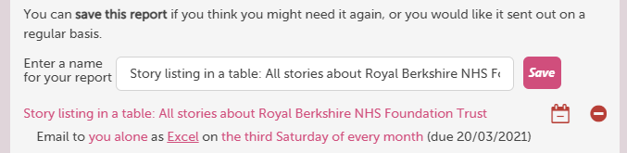

Slide 16
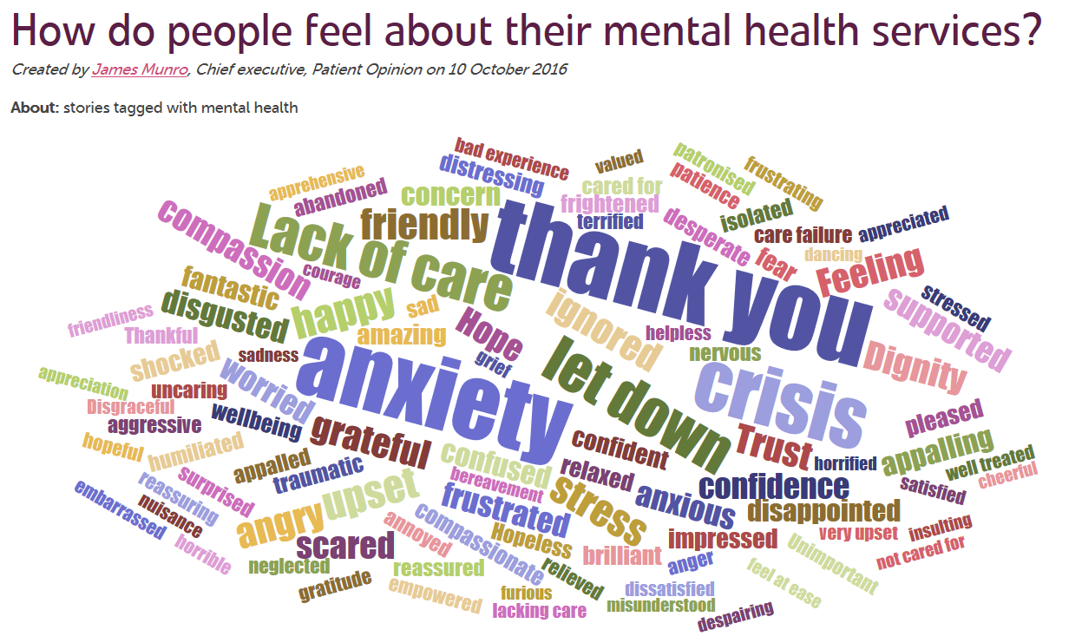

Slide 17
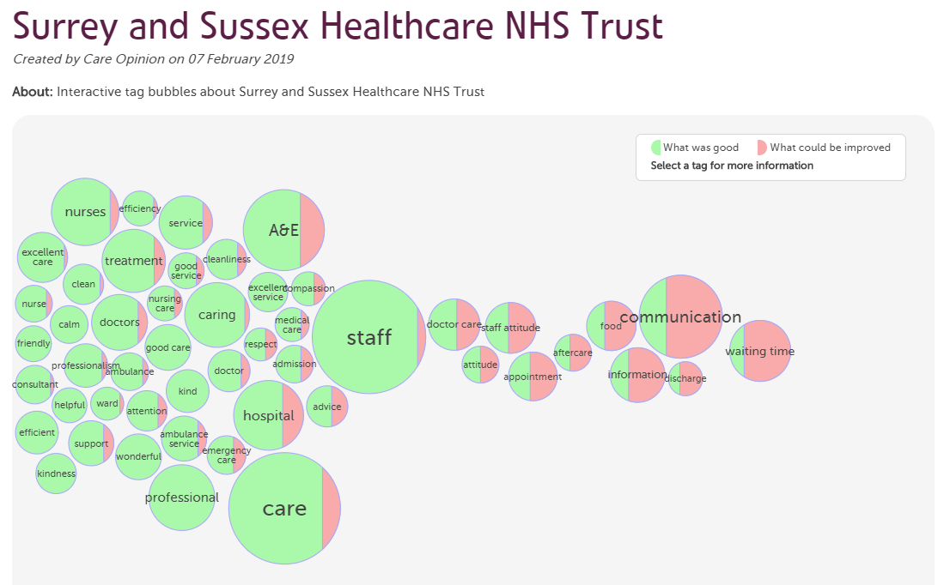

Slide 18
Subscriber tagging
Add private, subscription based or public tags to stories
Subscriber tagging allows for collaborative learning from stories.
Examples of tags that you could add: CQC domain names, stories that require a further response, names of projects or keeping track of examples you wish to use in meetings, reports, classes or case studies

Slide 19
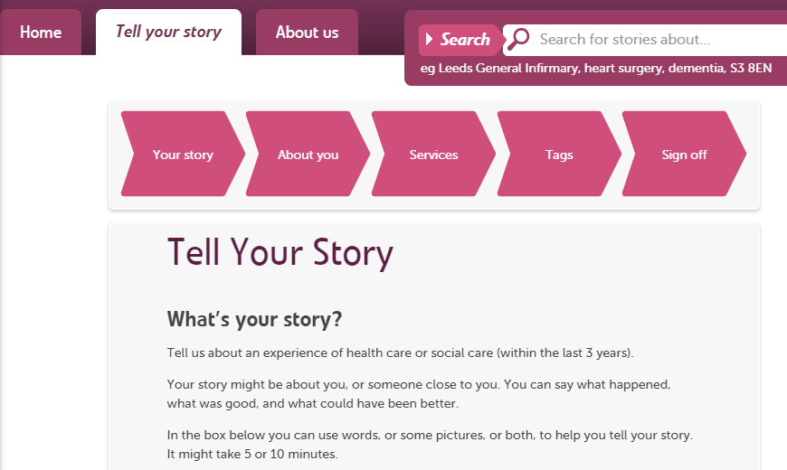
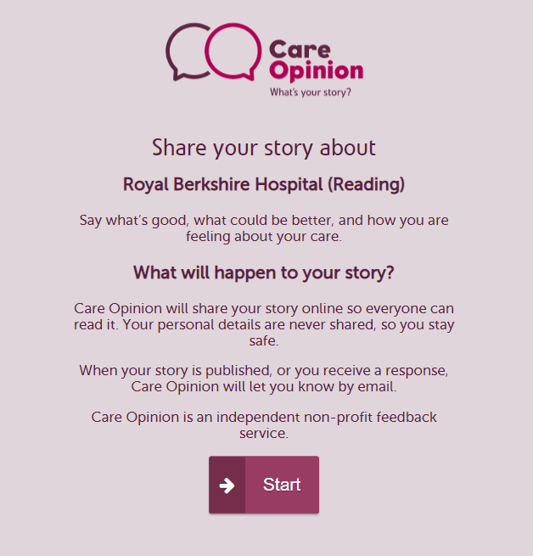

Invitation links, widgets, QR codes

Slide 20
An invitation link provides a memorable link, a QR code, and the ability to customise the story telling process
Standard workflow
Welcome
Story
Tags
Services
More tags
Sign off
Ratings
Select a welcome message
Add a feedback focus
Add your own tags
Pre-select a service
Offer your own online survey
Welcome
Story
Sign off
Ratings
Kiosk workflow

Slide 21









Research collaborations

Slide 22


Slide 23
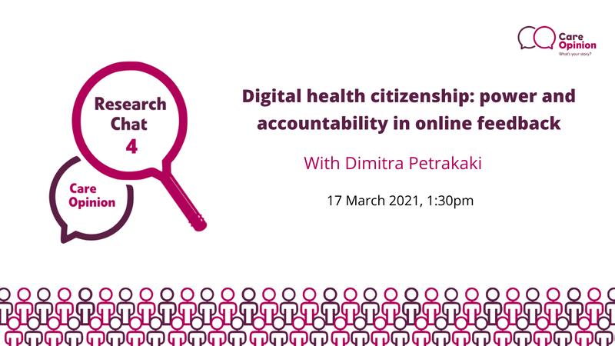
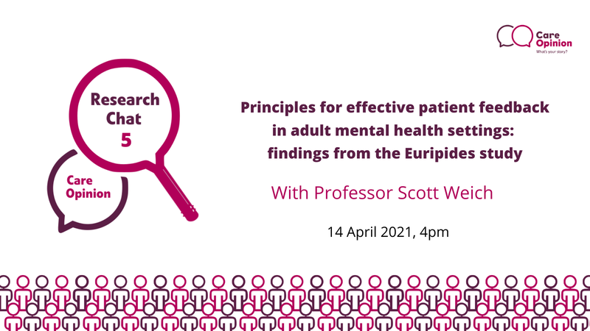

https://www.careopinion.org.uk/info/research-chats

Slide 24
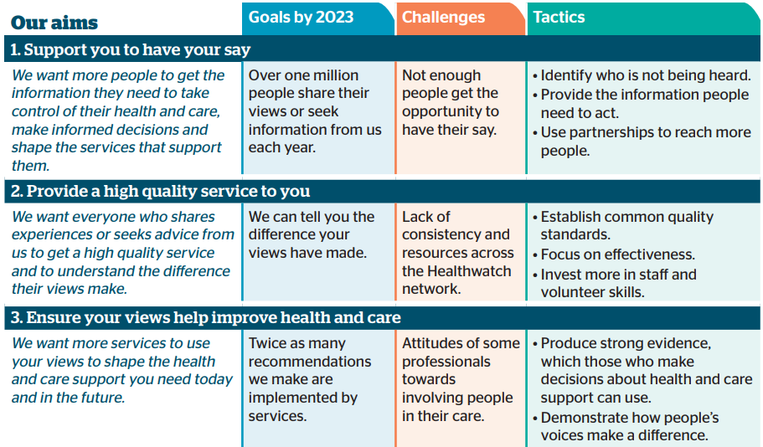
How can Care Opinion help?

Slide 25

“It’s brilliant for the patients but it’s also brilliant for the staff, because they can see the feedback.
And then they want to make it better.”
Dr Deborah Colvin, general practitioner, The Lawson Practice

Slide 26
Learn more
Staff perspectives
  https://www.pointofcarefoundation.org.uk/blog/implementing-online-patient-feedback-in-a-special-measures-healthcare-organisation/
Patient perspectives
  https://www.ncbi.nlm.nih.gov/books/NBK549387/
NIHR blog and review of research
  https://www.nihr.ac.uk/blog/we-are-missing-the-potential-of-patient-feedback/24336
Videos
  https://www.careopinion.org.uk/info/sharing-videos

