Slide 1


RDASH Care Opinion Webinar
Online patient feedback via Care Opinion - the RDaSH journey so far
13th October 2025

Slide 2
Aim of the Webinar
Steve Forsyth, Chief Nurse – a warm and enthusiastic welcome!
Paula Rylatt, Head of Quality and Promises/Patient Safety, Carer and Community Team – what is the trust aiming to achieve with Care Opinion, and how?
Natasha Collinson, Patient Safety, Carer and Community Team – how has the Care Opinion journey been so far?
Faye Braich, Clinical Lead & Cognitive-Behavioural Psychotherapist – learning from and responding to a story shared on Care Opinion
James Munro, Director of R&D, Care Opinion - available to answer questions about Care Opinion and research to date

Slide 3
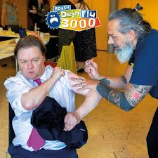


Steve Forsyth
RDaSHian
Dad
Husband
Nurse
Dad dog
Ex runner
Flu jabber

Slide 4
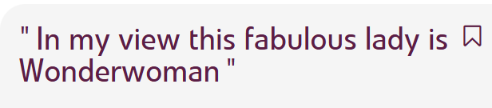
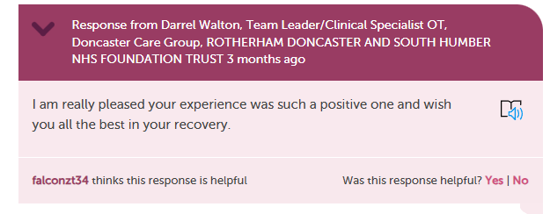
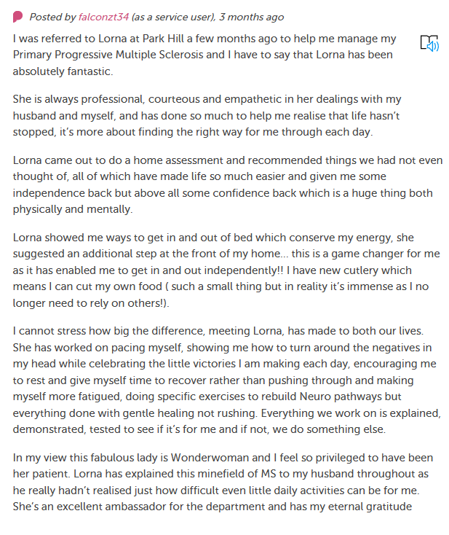
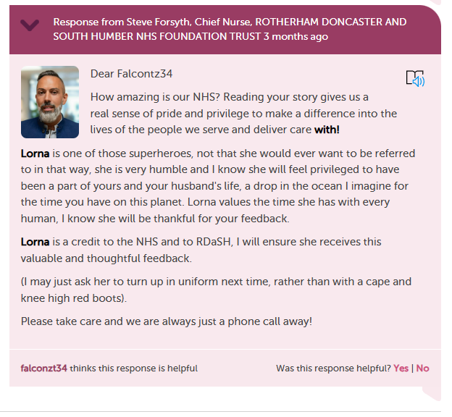

Slide 5
Paula Rylatt, Head of Quality and Promises/Patient Safety, Carer and Community Team
What is the trust aiming to achieve with Care Opinion, and how?

Slide 6
Why did RDASH choose to move to Care Opinion?
‘Your Opinion Counts’ limitations-
Paper based
Managed by a central team (PALS)
Manually inputted
Delays in receiving feedback from services
Why does feedback matter to us?
Continuous improvement, scale what's working well, patient and public voice is the one true barometer

Slide 7
How Care Opinion has changed patient feedback for RDASH
A true feel of what our patients think of RDaSH
Modernised and accessible
No longer open to interpretation (YOCS)
Timescales and real time feedback
Personalised responses
Response direct from the services
Anonymity
Availability of data and reporting – learning from feedback
Our patients & future patients are able to ‘google’ RDaSH

Slide 8
It’s part of our core strategy- Promise 4
Put patient feedback at the heart of how care is delivered in the trust, encouraging all staff to shape services around individuals’ diverse needs.
Continue to embed Care Opinion and implement Promise 4.
Work with the Care Groups and IT colleagues to share Care Opinion links via text message.
Work with the website team to make Care Opinion links available for every service listed on the public website.
Work with the Care Groups and Comms team to promote Care Opinion stories via social media.
Work closely with services we know do not receive many Care Opinion stories.
Celebrate our Care Opinion success with our staff.
Can we reach 200 stories per month!

Slide 9
Questions and Answers

Slide 10
Natasha Collinson, Patient Safety, Carer and Community Team
How has the Care Opinion journey been so far?

Slide 11

Our Journey
Steering group set up in May 2024
Officially became members in June 2024
Built the service tree
Early Adopters set up in June 2024
Held a number of training sessions
Really got started in September 2024
Officially removed YOC process in October 2024
1000 stories by May 2025

Slide 12
The story so far ...
There are 1783 stories about RDASH listed on Care Open in total.
1653 stories have been told since the ‘go live’ date of 1st June 2024.
To date the stories have been viewed 206,061 times.
We currently receive approximately 160 stories per month.
We have 405 members.
190 individual services are listed.
We have an 80% response rate (on the last 100 stories told).
82% of the stories told were positive.
587 of the stories told praised our staff.
61 of the stories told, stated that communication could be improved.
1196 people would recommend our services.
79 people would not recommend our services.

Slide 13
Myth Busting
Our patients won’t post on a public website
No one reads the stories
Older People won’t go online to provide feedback
You can’t post a story without an email address
Our patients won’t be willing to share their email address
Over 70% of stories come direct from the patient.
Over 60% of the story authors who have provided their age (optional) are older adults.
Over 80% of stories are received on-line with an email address.
Our stories have had nearly 200,000 views.
There are other options for patients who do not have access to the internet, do not have an email address, or do not feel comfortable sharing this information.

Slide 14
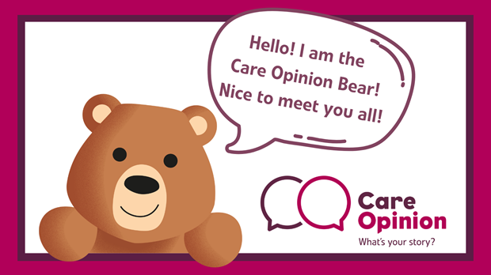
How patients can share their story …
Directly via the Care Opinion website
  On the website stories can be told by picture
  Children and young people can share their story with the help of Bear!
Via QR code or online link that will direct the author to the right service page
Via leaflet
Via telephone – 0800 122 3135
Staff can post a story on behalf of the patient – there is a toolkit available to support staff with this
74% of stories were received via QR code
13% direct to the website
7% via leaflet
2% via telephone
3% unknown

Slide 15
Faye Braich, Clinical Lead & Cognitive-Behavioural Psychotherapist
Learning from and responding to a story shared on Care Opinion

Slide 16
My journey as a Care Opinion user
I gained the ability to respond to Care Opinion feedback around eight months ago
I’ve responded to 64 stories since then!
Every piece of feedback from one of our patients is a gift; it gives us the opportunity to understand more about the patient journey and enables us to shape services around the needs of the people we support.
Being compassionate may come easily to us as healthcare workers, but conveying that compassion via the written word can take some practice. And that’s okay!
My favourite stories are the ones where things haven’t gone so well, as this is where we can make the greatest impact. People understand that things can go wrong, it’s how you make it right that matters.

Slide 17
How to write a great response
Address the writer, introduce yourself, explain what your job role is and explain why you specifically are responding
If it’s been more than seven days since the feedback was posted, apologise for the delay and explain why there has been a delay
Thank them for their time in writing and posting feedback, express why you appreciate it
If the feedback is positive, explain how you will pass this along to the staff members involved
If the feedback involves a problem or unhappy experience, empathise with how difficult this might be from their perspective and assure the writer you’re here to listen and to support them with this
Share the next steps you’d like to take with the writer, for example saying that you would really appreciate the opportunity to speak with them so you can decide together on a way forward
Make sure you’ve explained how the writer can contact you, state that you’re really looking forward to hearing from them, and sign off in a caring way

Slide 18
Tips
Make sure you’ve uploaded a photo of yourself to your Care Opinion account so people can put a name to the face
Mirror the length of the story
Remember that your responses are an advertisement for the service, and anybody can see them (including potential patients)
Don’t be afraid to ask someone else to review your response before you post it
Spend some time reading other responses from other services to figure out your own style and see what works well
Tailor your response to make it clear you’ve fully read and absorbed the feedback, for example reflecting on what the writer has shared about why they came into the service
Avoid copy and paste responses
The patient has already reached out to share their experience with you: respond to it, don’t just acknowledge it and ask them to contact you a different way again

Slide 19
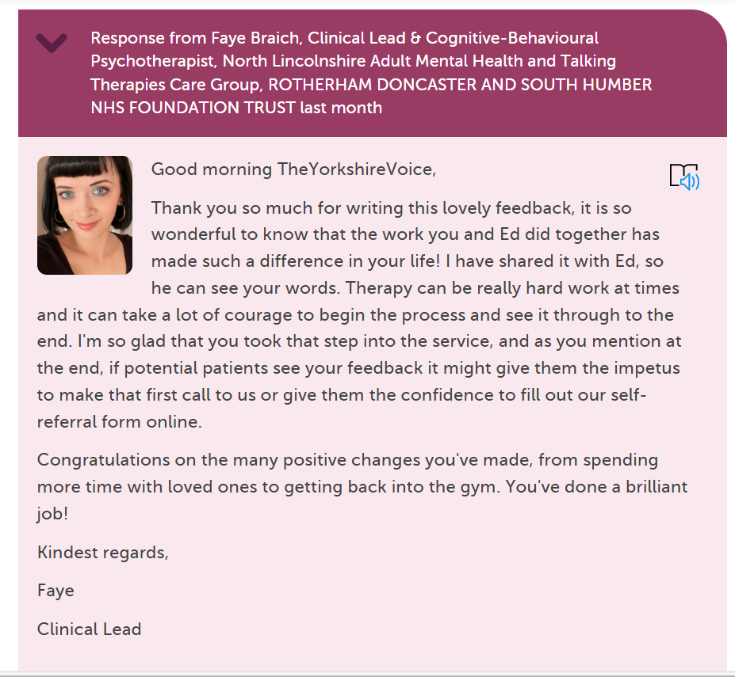

Slide 20
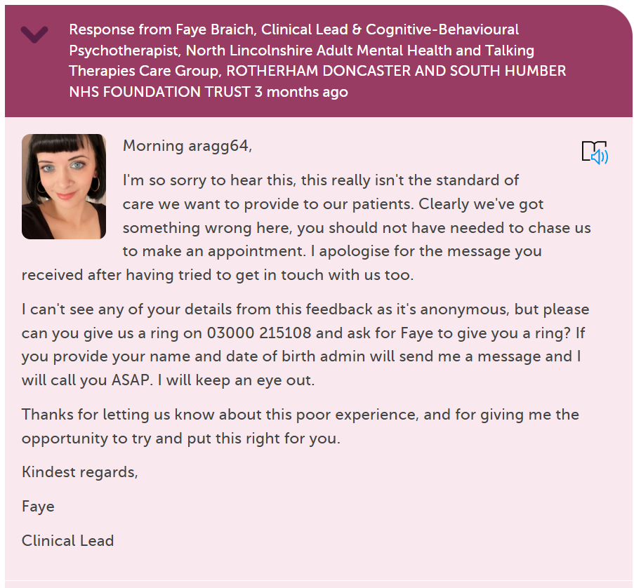

Slide 21
Any Questions?

