Slide 1


Introduction to Care Opinion – The Basics

Slide 2


Slide 3
Aim of the session
Who is Care Opinion?
The ‘Story Telling Process’
Live demo (performed by our Danielle) of how to access the site and some of the key features including:
  Logging in
  Updating your profile
  Finding the service you work for and your saved things
  How to find support and help
An opportunity for Q & A-hold nothing back and anything we can’t answer, we will be sure to follow-up in an email post webinar

Slide 4



Who are we?
Care Opinion is a non-profit social enterprise, based in Sheffield and Stirling.
We have been sharing people’s experiences of health and care services online since 2005, and we have built a national and international reputation for our innovative and value-led approach to online feedback.
At Care Opinion we make it safe and simple to share your story online and see other people's stories too. You can see how stories are leading to change.
How is Care Opinion funded? | Care Opinion
Meet the Care Opinion team | Care Opinion

Slide 5
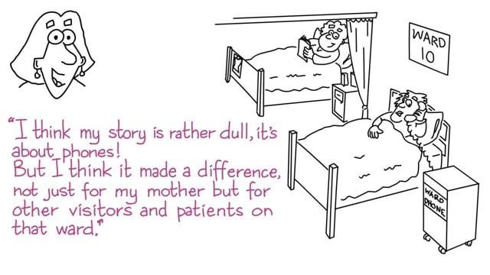
Care Opinion in 2 minutes
Watch this short video to find out more about Care Opinion.
Notes:
Embed code is available for you to use this video on your site.

Slide 6

Mission, Vision & Values
Our vision
What do we want to see?
We want people to be able to share their experiences of health and care in ways which are safe, simple, and lead to learning and change.
Our mission
Our mission, in a nutshell, is to provide an online platform so that people can share honest feedback easily and without fear
Our values
How will we pursue our mission?
Innovation Transparency Inclusivity Positivity Humanity

Slide 7
Understanding member roles
Browse, search and view stories and responses
Manage their own email alerts/assets
Create, export and schedule reports
Create, share and schedule data visualisations
Add private and shared story tags
Respond to stories and show changes
Create and publish blog posts
Create Invitation Links
Add public story tags
Add and remove subscription members
Freeze and unfreeze subscription members
Change the role of a member
Edit a members profile details
View, edit & amend members assets
Respond on behalf of another member
Manage assets/alerts for other members
Create Invitation Links & transfer ownership
Customise service pages
Access API keys
Member
Responder
Administrator

Slide 8



Ways to share a story with Care Opinion
Online careopinion.org.uk or careopinion.ie
Freephone 0800 122 3135 (UK only)
Freepost leaflets
From an invitation link
With support from Volunteers
Using picture tiles
All stories are subject to moderation and are uploaded to the website

Slide 9
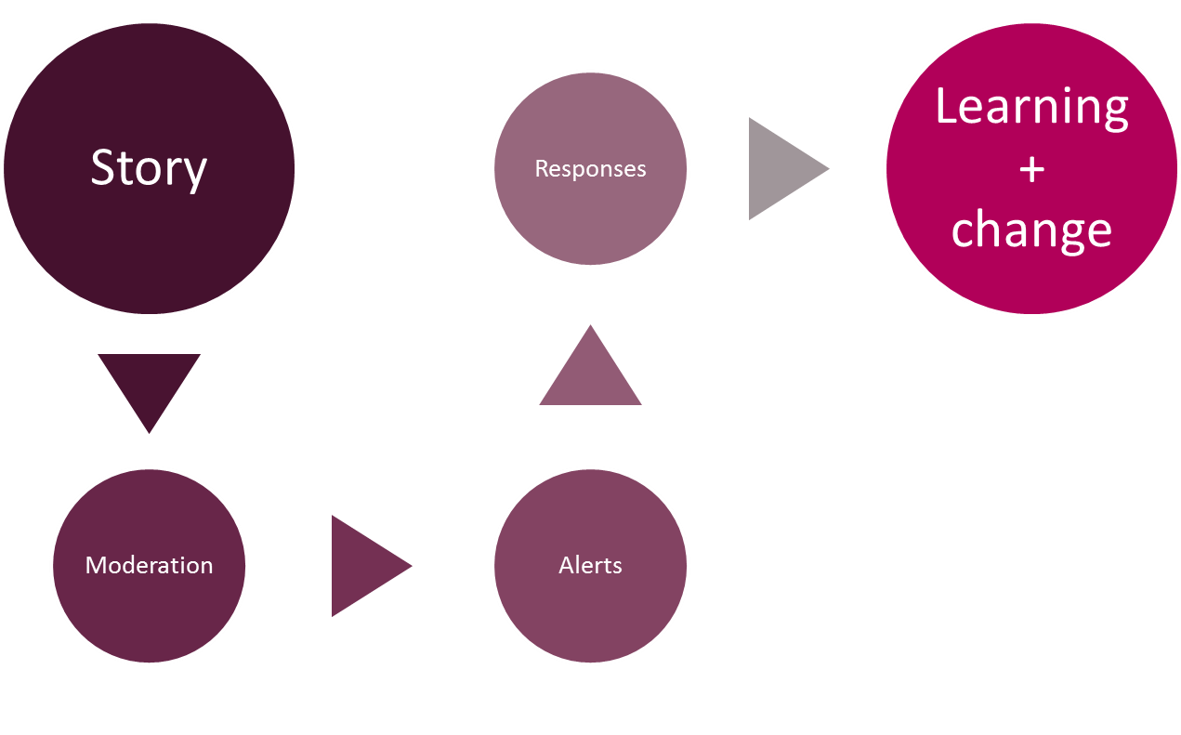
The story-telling flow – it’s about the conversation

Slide 10
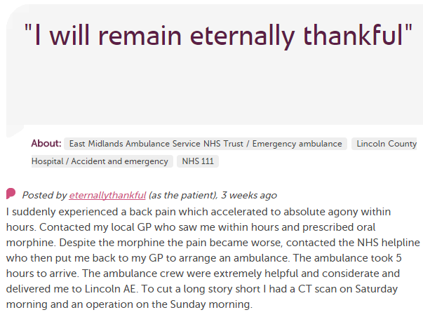










In each provider
Moderation
Service staff
Different Staff Teams
User exp, comms, complaints…
Alerting
CEO
Commissioners
Nursing, AHP students
Healthwatch
Researchers
Other Stakeholders
CQC

Slide 11
Accessing the site

Slide 12


Live site demo
We will cover:
Logging in to the Care Opinion site
Updating your profile details
Searching for your service/ward
Saving your service/ward
Creating an alert for stories about your service/ward
Checking these in your ‘Saved things’
We have some supporting slides that we will email to you after the webinar.
Follow this Link to the Subscriber ‘Know how’ page where you can find helpful support pages on things you might need to know-how to do on the site.

Slide 13





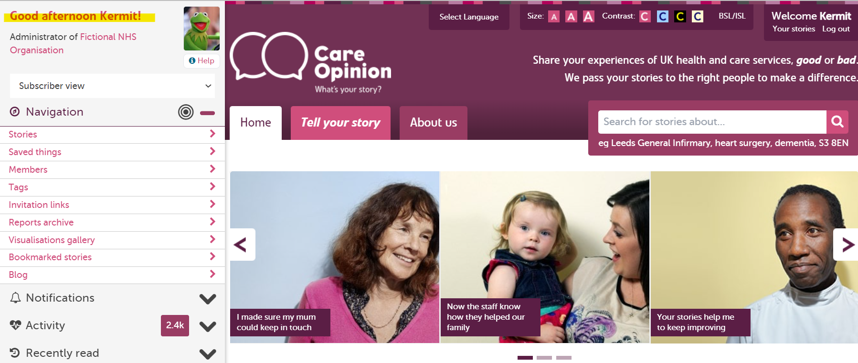
Notes:
Change this to sub admin

Slide 14

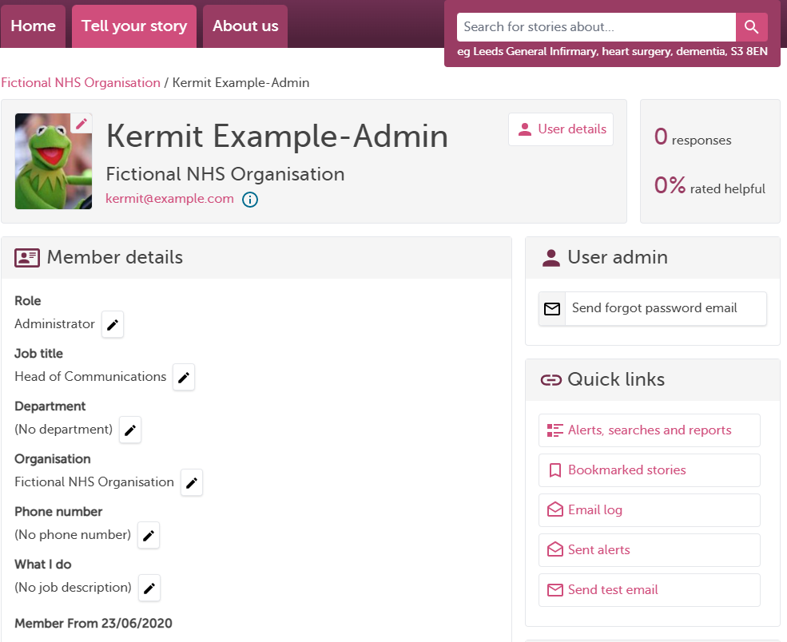





Slide 15

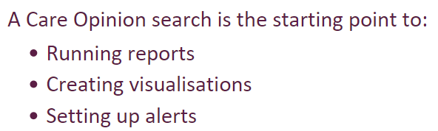
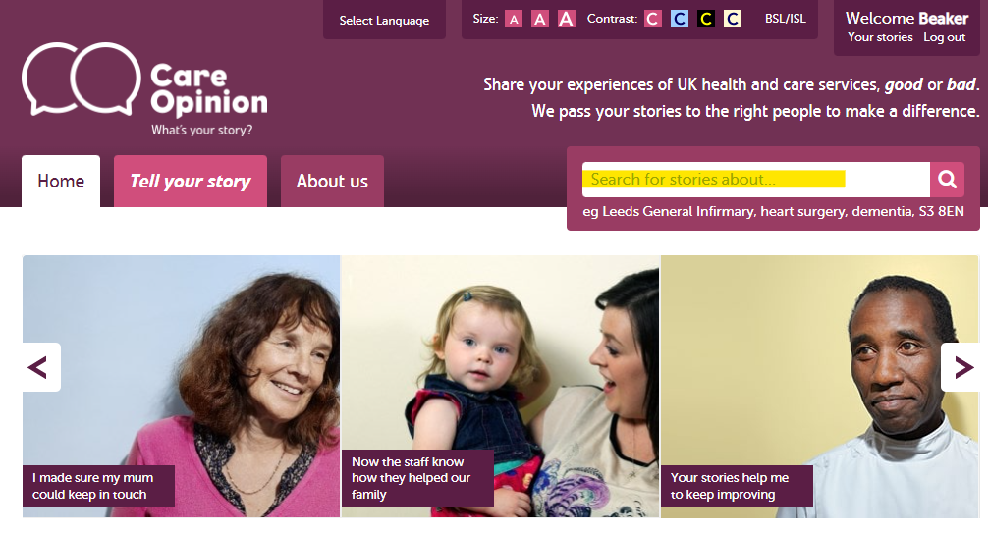


Slide 16

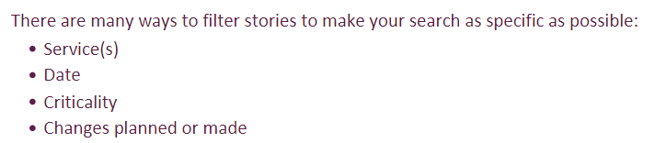
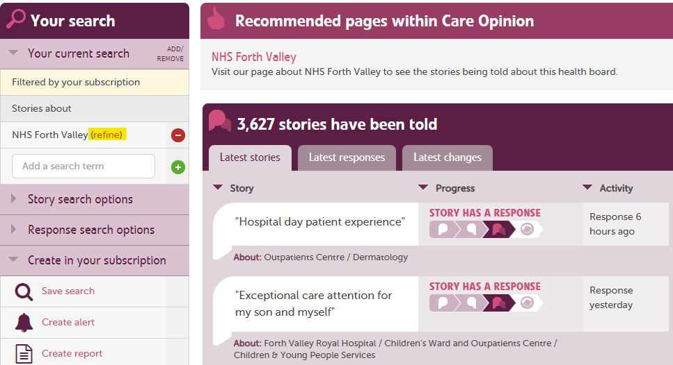


Slide 17
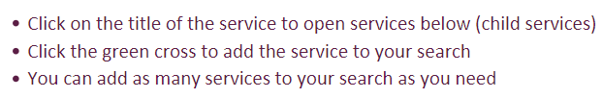
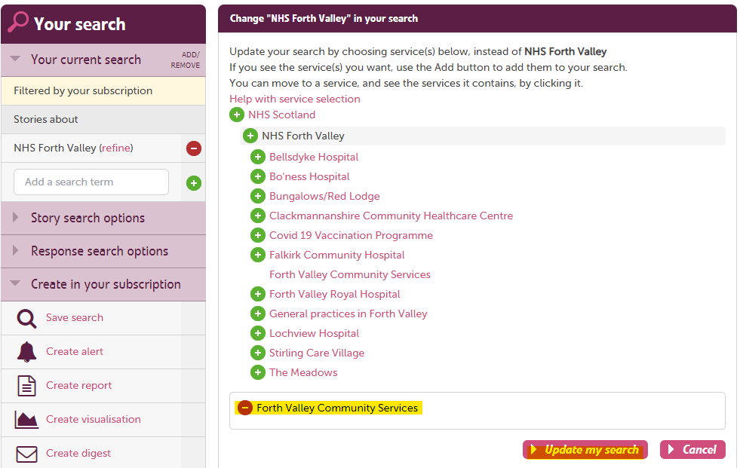


Slide 18
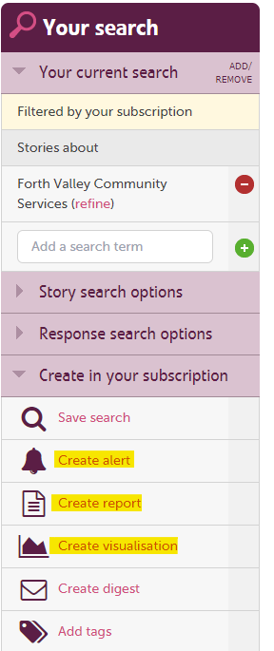






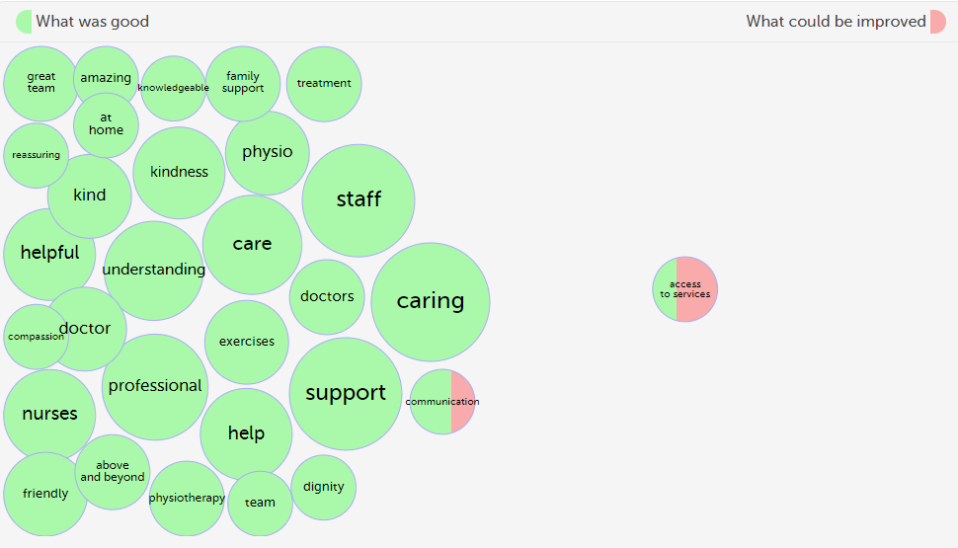

Slide 19
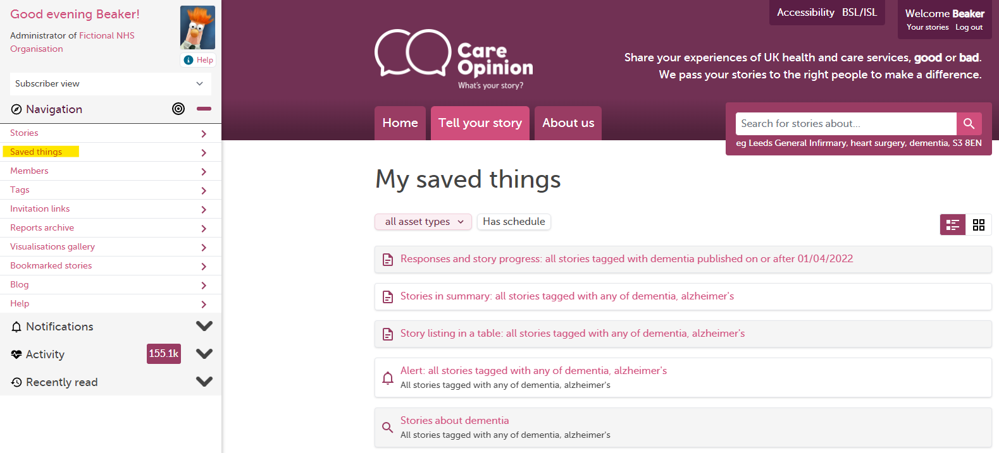

Slide 20
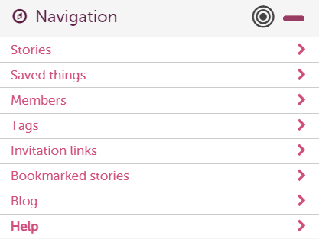

How to find help?
Help button
Support page
Contacting your support lead
Emailing info@careopinion.org.uk

Slide 21

Future ‘How to’ sessions
Here is a link to the future sessions:
Training and support webinars | Care Opinion

Slide 22


Slide 23
Thank
you

